Slide 1
Guide to Retirement
Retirement Insights
2023

Slide 2
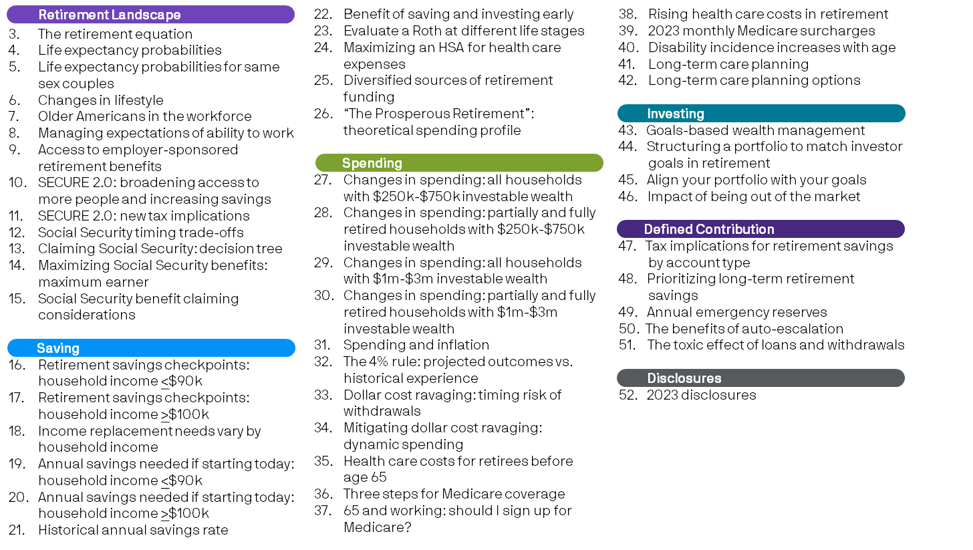
Page reference
Retirement Landscape
Saving
Spending
Investing
Defined Contribution
Reference

Slide 3
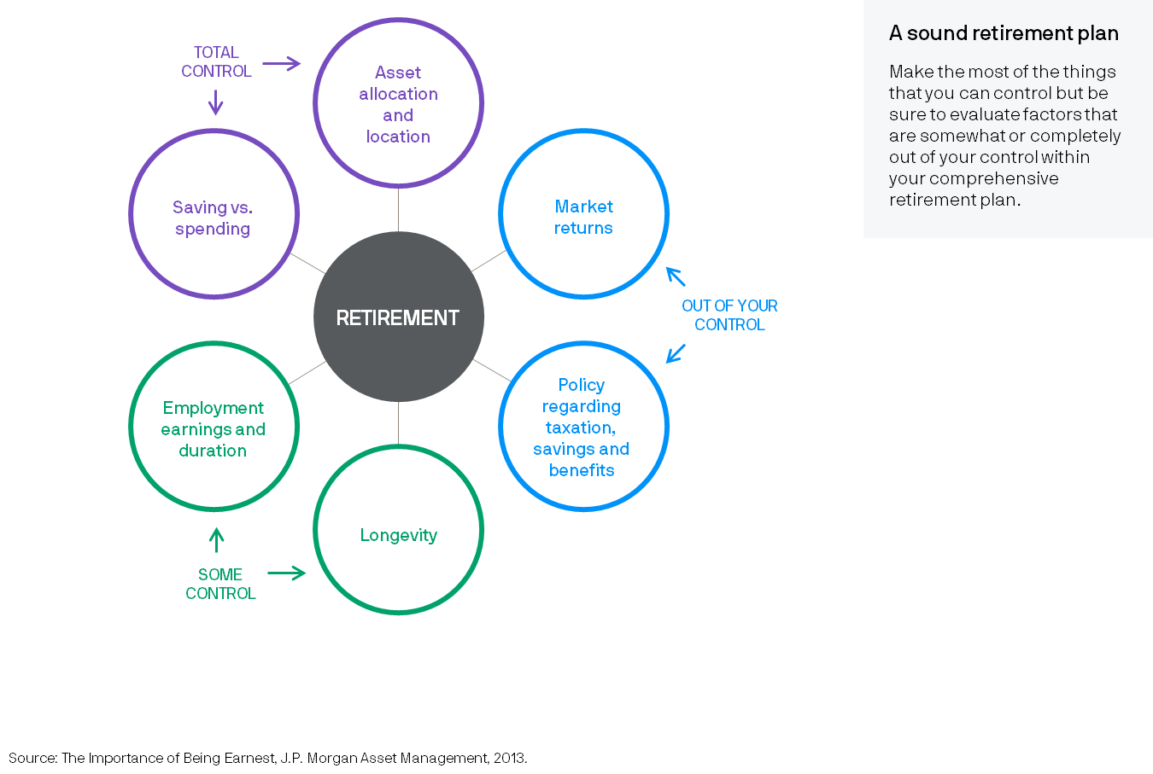
The retirement equation
3
Retirement Landscape
Notes:
Planning for retirement can be overwhelming as individuals navigate various factors over which there are varying levels of control. There are factors that are out of their control, like market returns and the future of tax policy, legislative and regulatory reforms, and factors over which they have some control, like longevity and how long they work. The best way to achieve a secure retirement is to develop a comprehensive retirement plan and to focus on the factors that can be controlled: maximizing savings, efficiently utilizing tax-advantaged accounts, understanding and managing spending and being well diversified in their investment strategy.

Slide 4
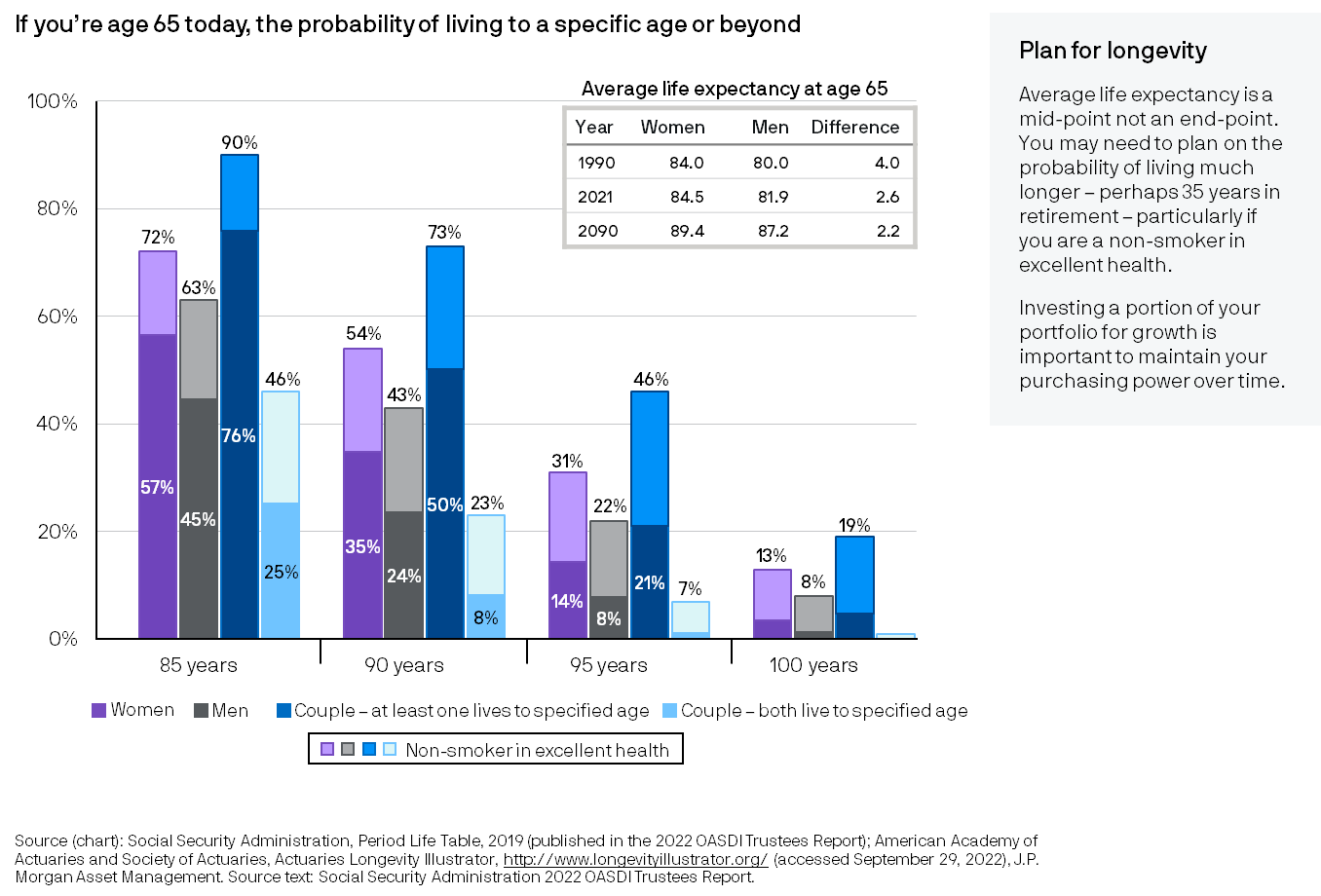
Life expectancy probabilities
4
Retirement Landscape
Notes:
While the recent impact of the pandemic is not yet reflected in the life expectancy tables, life expectancies in the United States continue to increase as more people are living to older ages. This chart shows the probability that 65-year-old men and women today will reach various ages. For a 65-year-old couple, there is nearly an even chance that one of them will live to age 90 or beyond. Individuals should plan for living well beyond the average – to age 95 or even 100 – especially those in good health. For non-smokers in excellent health, there is almost one in three chance that women will live to age 95 or beyond and one in five chance that men will live to age 95 or beyond.

Slide 5
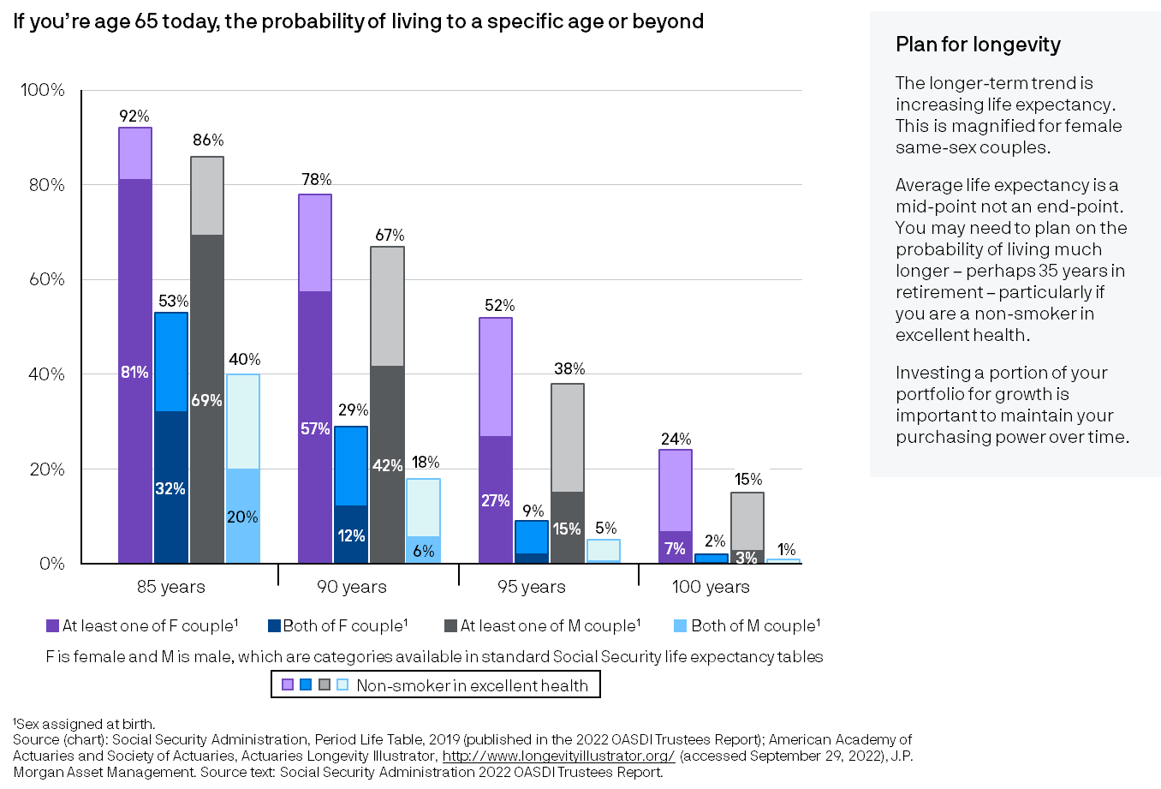
Life expectancy probabilities for same sex couples
5
Retirement Landscape
Notes:
While the recent impact of the pandemic is not yet reflected in the life expectancy tables, life expectancies in the United States continue to increase as more people are living to older ages. This chart shows the probability that 65-year-old same-sex couples today will reach various ages. For those assigned female at birth, the chance for a long life is magnified, with a more than even chance at least one non-smoker in excellent health will live past age 95. For couples assigned male at birth who are non-smokers in excellent health, nearly 4 in 10 are expected to live to age 95 or beyond. Individuals should plan for living well beyond the midpoint of life expectancy.

Slide 6
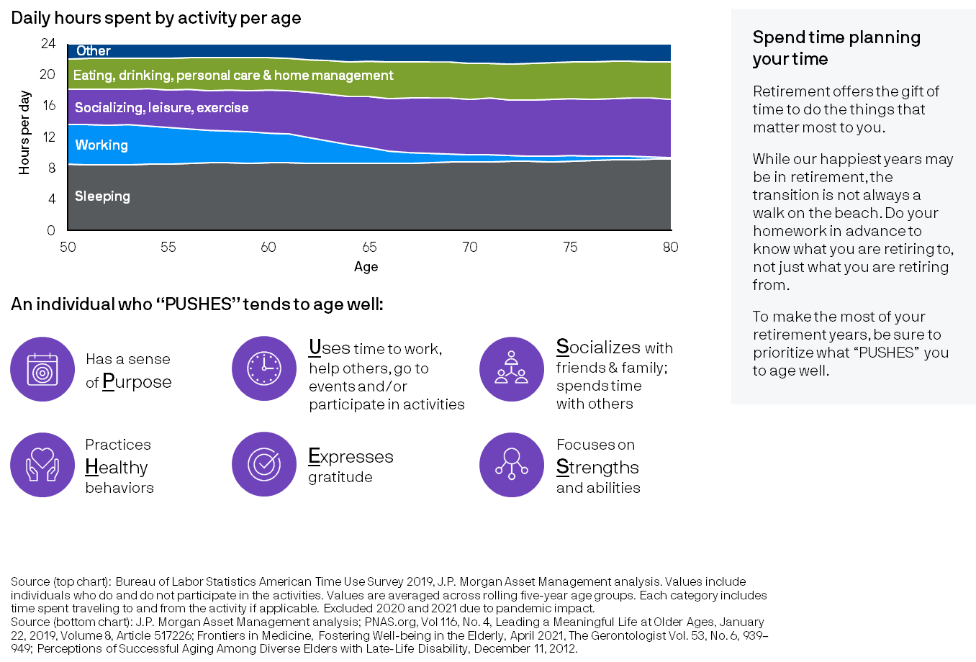
Changes in lifestyle
6
Retirement Landscape
Notes:
As households transition into retirement, time that had been spent working now is available for other pursuits. Individuals often enter retirement having spent too little time determining how they plan to spend this time – and run the risk of not enjoying retirement as much as they had anticipated. To age well, consider these "PUSHES" to feel satisfied and flourish at older ages.

Slide 7
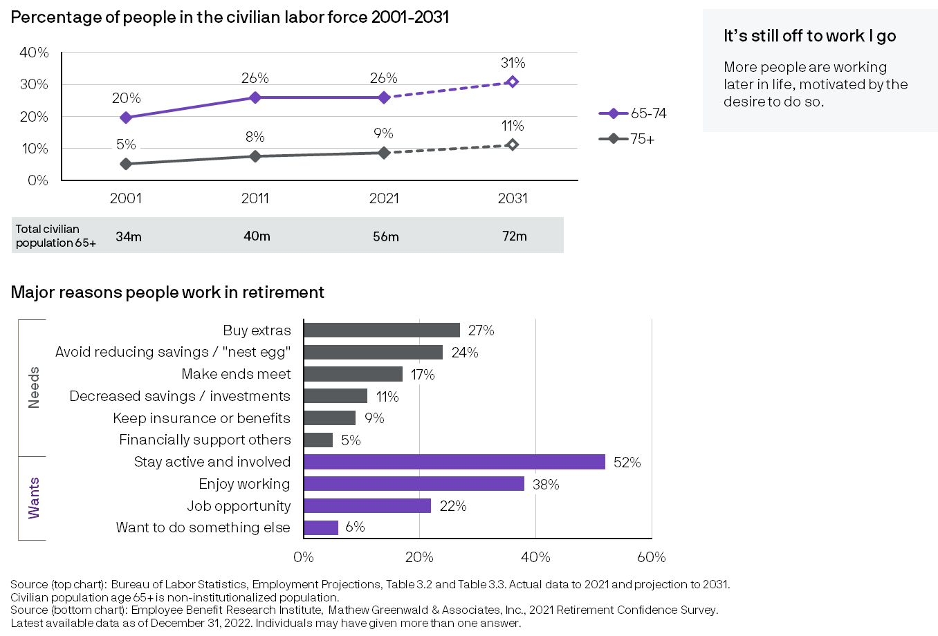
Older Americans in the workforce
7
Retirement Landscape
Notes:
More people continue to work at older ages, although there was a light leveling off 2021, possibly due to the pandemic. The bottom chart shows why people work in retirement and highlights that the definition of retirement is changing: more people work due to positive reasons such as wanting to stay active and socially engaged more so than for financial reasons. Although more Americans are expected to continue working later in life, there will be many more retirees in the future as the gray shading in the middle shows. This demographic shift has implications for our society and retirement system.

Slide 8
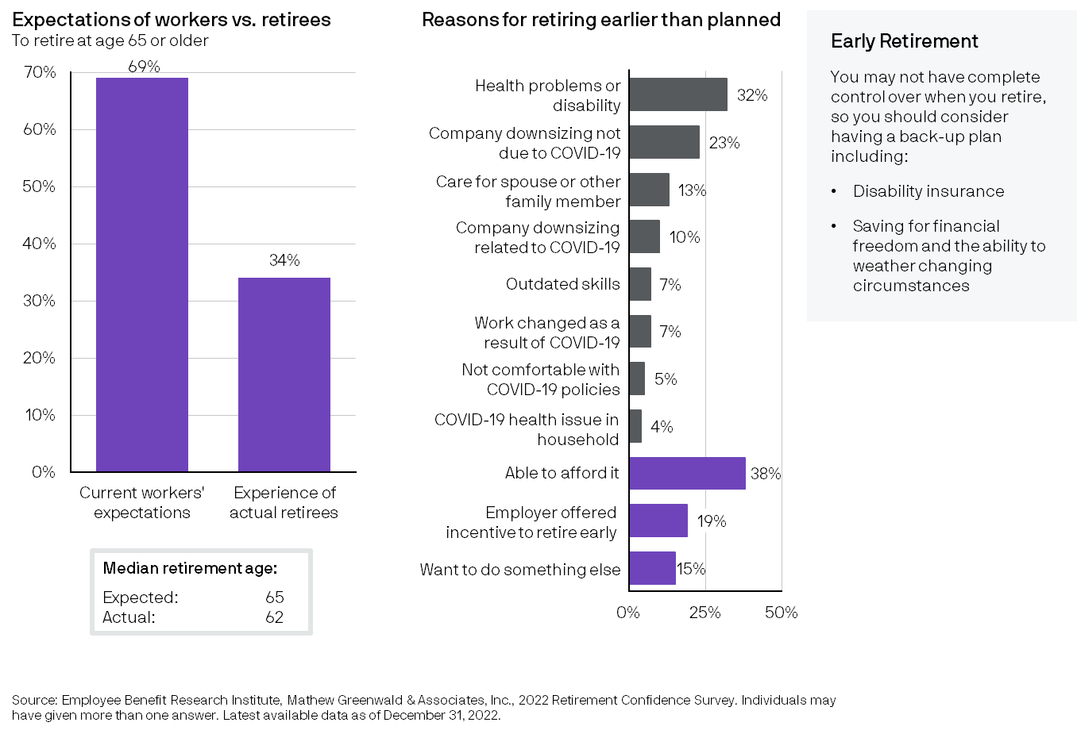
Managing expectations of ability to work
8
Retirement Landscape
Notes:
While many people want to continue working later in life, not everyone can. A very high percentage of those who are currently working expect to work to age 65 or later, but the actual experience of retirees is quite different. Nearly a third of retirees said they retired earlier than expected primarily due to health problems or disability, or due to changes at their company. It is very important that clients have a financial back-up plan if they are not able to work, and disability coverage to protect income should be considered if an individual or family is highly dependent on income from employment.

Slide 9
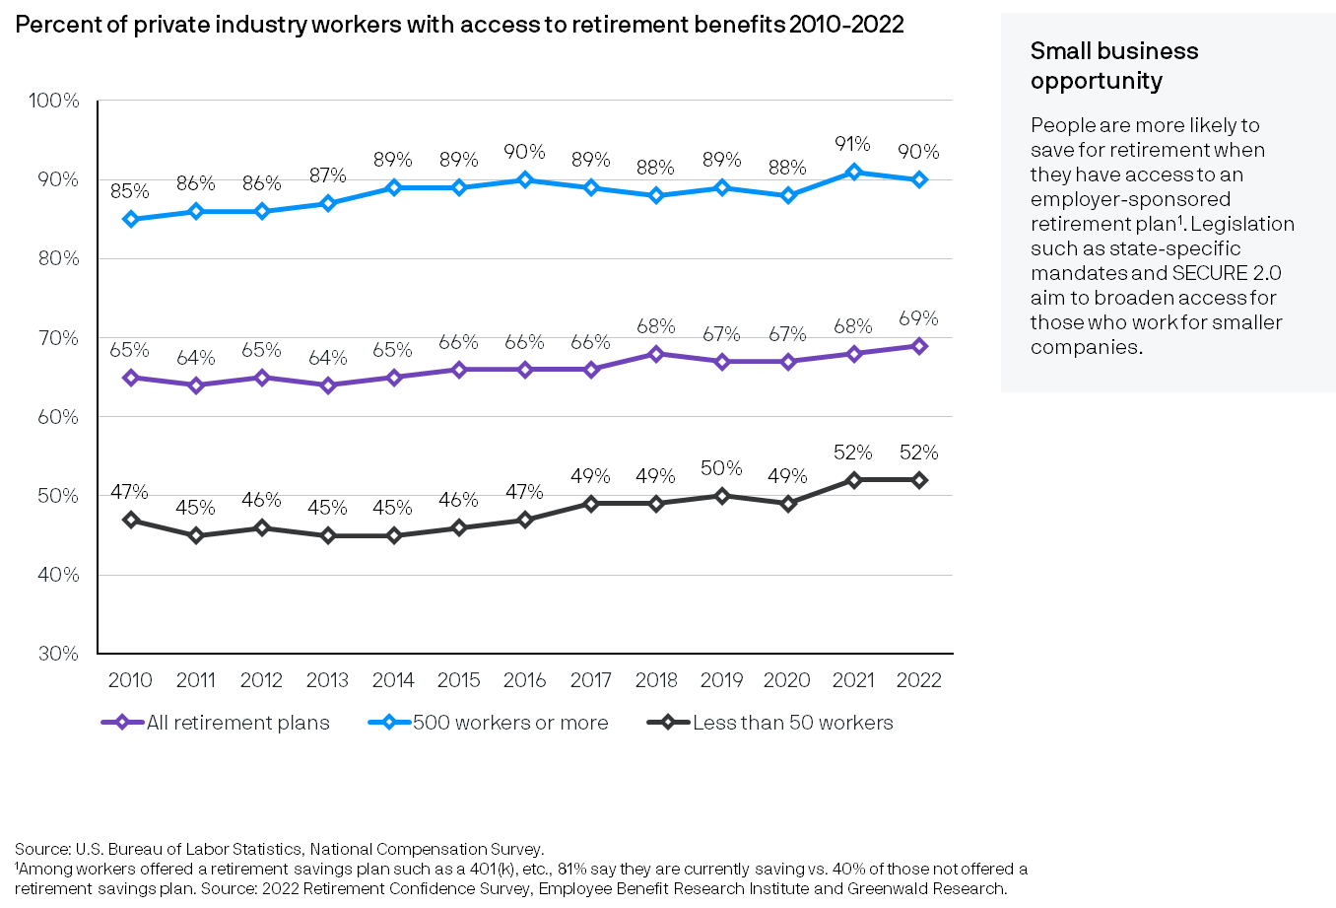
Access to employer-sponsored retirement benefits
GTR
9
Retirement Landscape
Notes:
Having access to an employer-sponsored retirement plan significantly increases the likelihood that people are saving towards their retirement. Employee Benefit Research Institute found in its most recent Retirement Confidence Survey that 8 out of 10 people with an employer-sponsored savings plan such as a 401k are saving for retirement vs. only 4 out of 10 people without a plan. Saving and investing early is one of the key drivers of achieving successful retirement but unfortunately, not all companies sponsor a retirement plan for their employees due to the administrative burden and cost.
This slide shows the percentage of workers in the private sector, who have access to retirement benefits through their work. While the average is about 7 out 10 people who have access to retirement benefits, it’s mostly workers who work for larger companies than those who work for smaller companies. To deal with this disparity while recognizing the challenges faced by many small businesses, recent legislation such as state-specific mandates and SECURE 2.0 aim to broaden access for those who work for smaller companies.

Slide 10
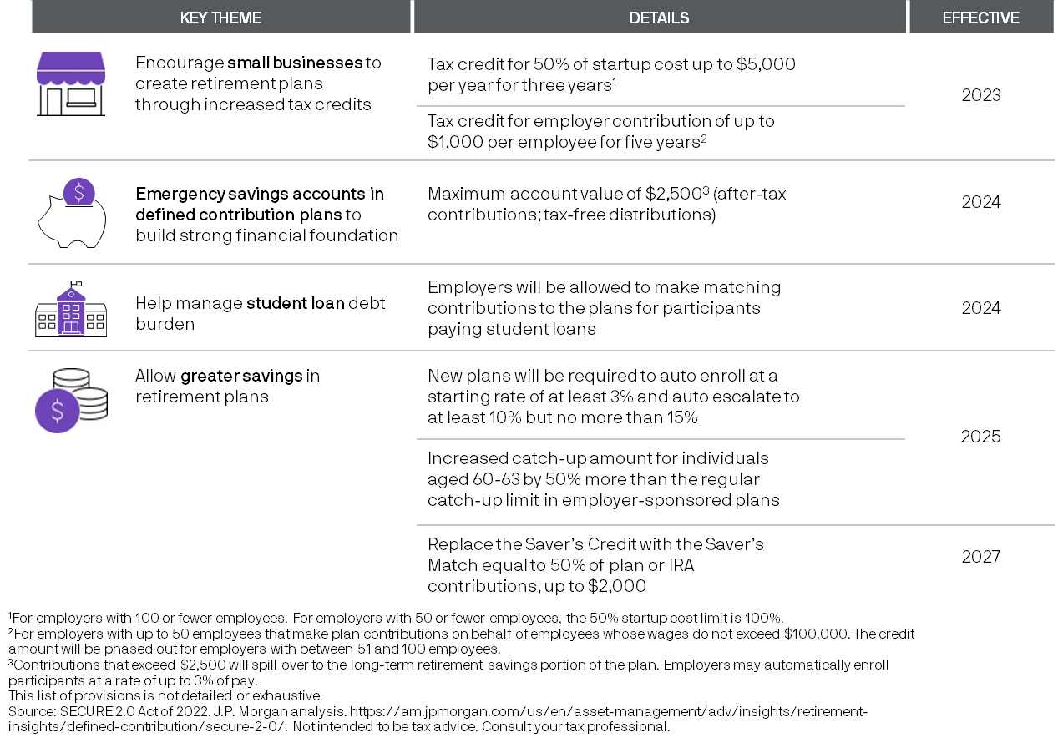
SECURE 2.0 Act of 2022: broadening access to more people and increasing savings
GTR
10
Retirement Landscape
Notes:
SECURE 2.0 is follow-up to 2019 legislation that covers employer retirement plans and IRAs. One of the main implications for individuals is increased savings opportunities in tax-advantaged accounts, including tax credits that may encourage small businesses to sponsor retirement plans. In 2024, the Act will allow emergency savings in defined contribution plans and company matching funds into the retirement plan for participants paying student loans. Other provisions to bolster retirement savings will follow in 2025 and 2027.

Slide 11
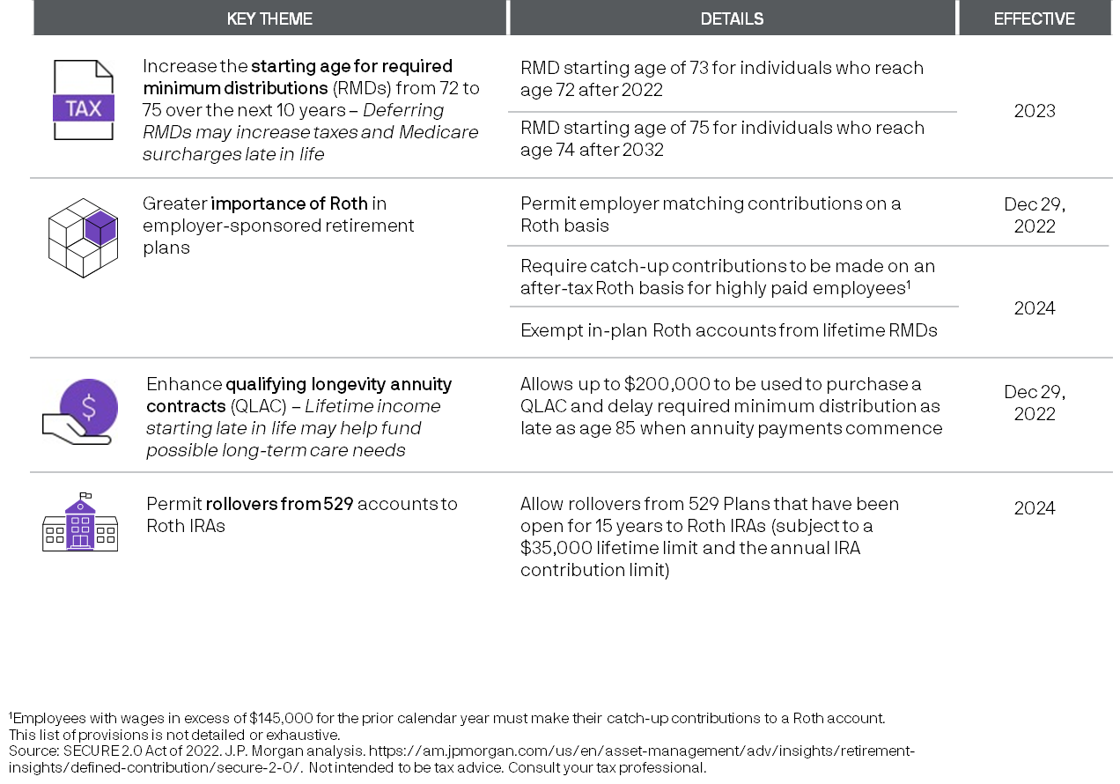
SECURE 2.0 Act of 2022: new tax implications
GTR
11
Retirement Landscape
Notes:
SECURE 2.0 also has several implications related to tax-advantages of retirement accounts. Delayed RMDs (or Required Minimum Distributions) for some individuals, increasingly allowing or even mandating Roth accounts in some cases and permitting limited rollovers from 529 into Roth accounts are some of the provisions getting the most attention.

Slide 12
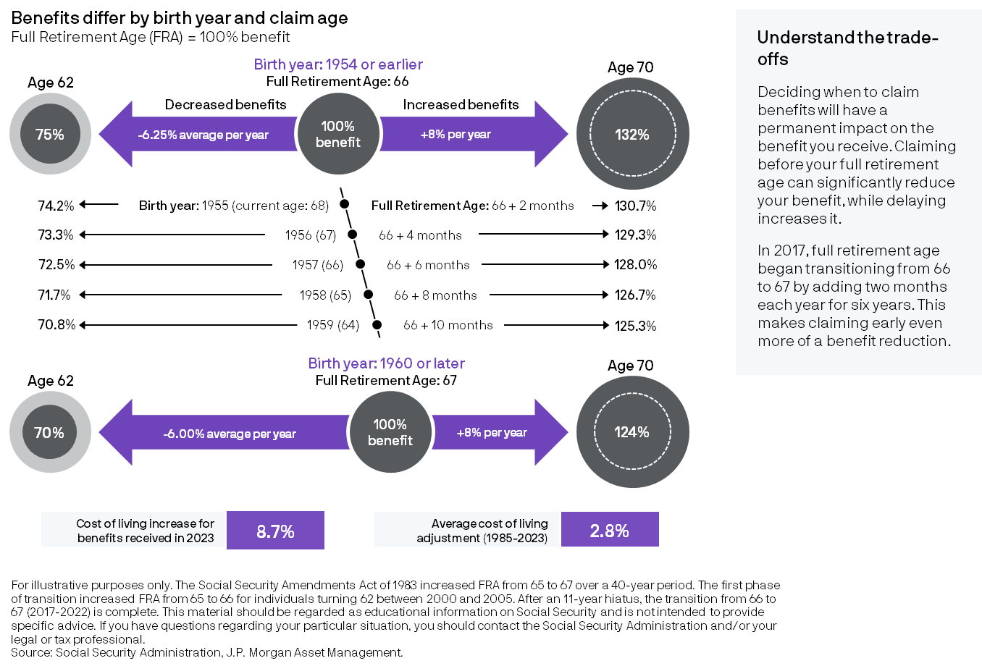
Social Security timing trade-offs
12
Retirement Landscape
Notes:
Surprisingly few Americans understand the benefits and trade-offs related to claiming Social Security at various ages. The top graphic illustrates these trade-offs for people whose Full Retirement Age (FRA) was age 66. The bottom graphic is for individuals turning 62 in 2022 or later whose FRA is 67. Delaying benefits results in a much higher benefit amount: Waiting to age 70 results in a 24-32% more in a benefit check than if they had claimed at their FRA. Likewise, taking benefits early will permanently lower the benefit amount. At age 62, beneficiaries would have received only 70-75% of what they would get if they waited until their FRA. The percentages shown are “real” amounts – cost-of-living adjustments (COLA) will be applied over time, providing an even greater difference between the actual dollar benefits one would receive. While the COLA adjustment for 2023 benefits was 8.7%, the average annual COLA over the past 38 years has been 2.8%.

Slide 13
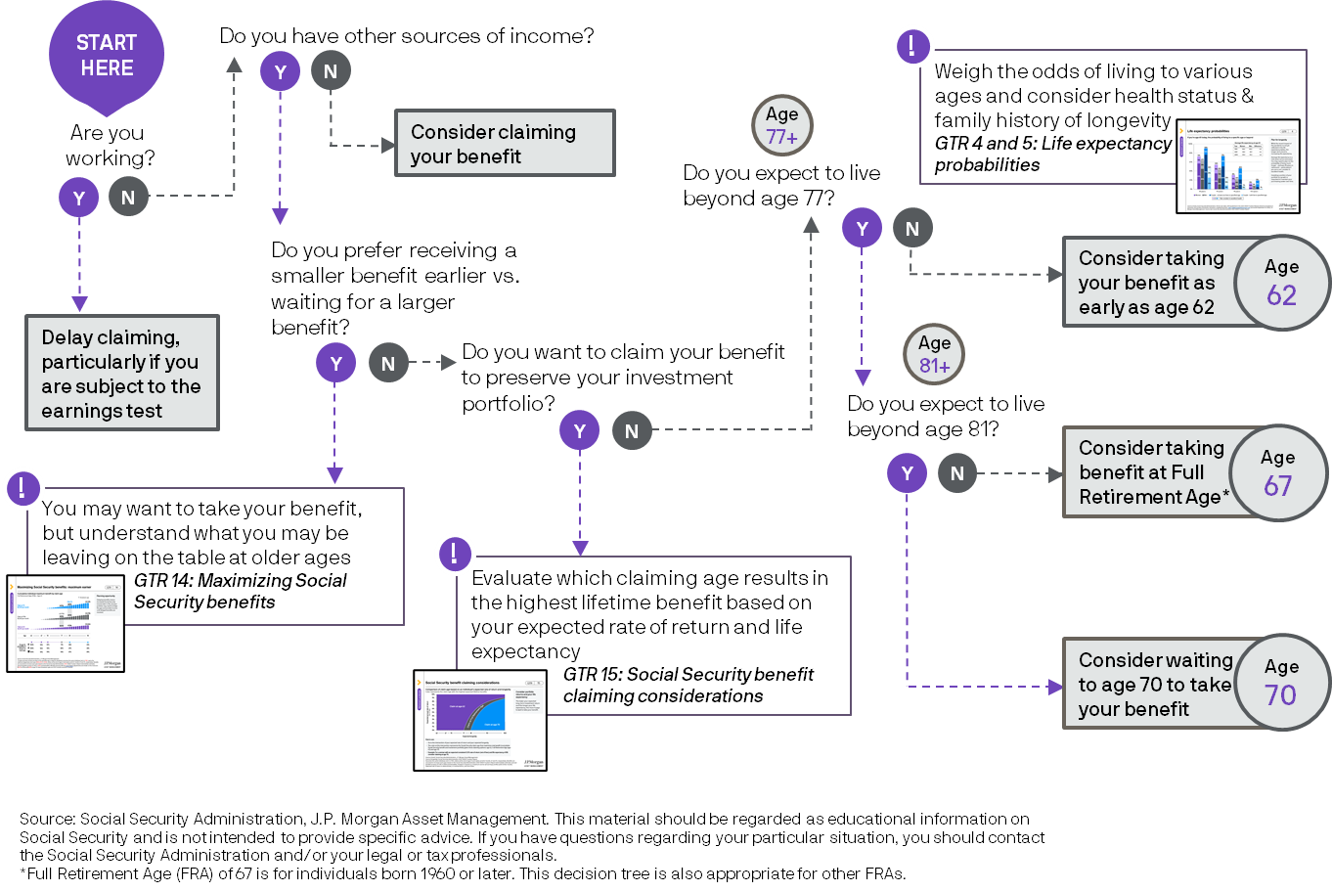
Claiming Social Security: decision tree
13
Retirement Landscape
Notes:
This decision tree is designed to help individuals think through some of the factors related to when to take Social Security benefits. Working, having other sources of income, expected longevity, preserving a portfolio and trying to maximize benefits are important considerations. The possibility of benefits for family is not included; individuals should contact the Social Security Administration if they have questions about their personal situation.

Slide 14
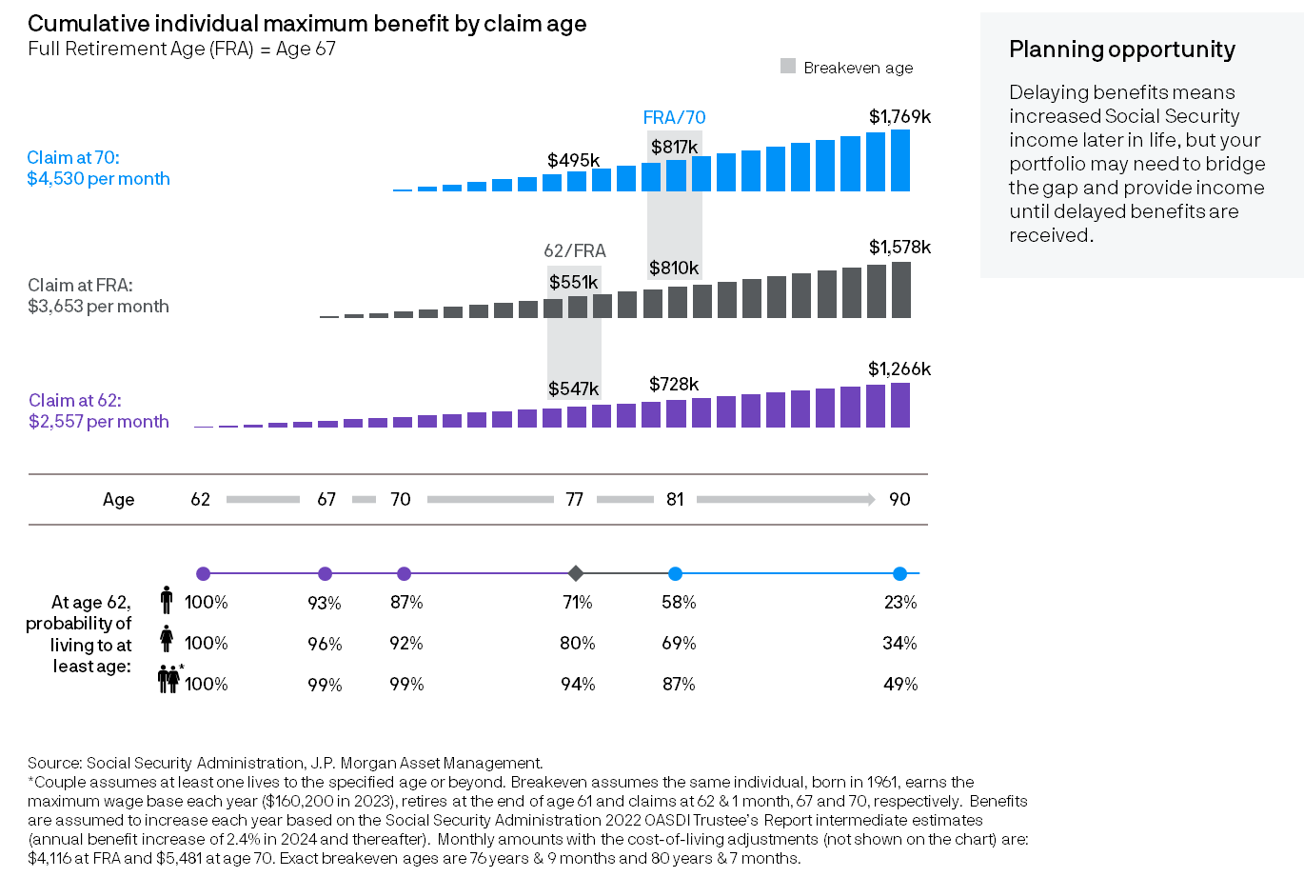
Maximizing Social Security benefits: maximum earner
14
Retirement Landscape
Notes:
The age at which one claims Social Security affects the amount of benefit received. Key claiming ages are 62, Full Retirement Age (which is 67 for individuals turning 62 in 2022) and 70. The bar charts show the most common ages an individual is likely to claim and the monthly benefit they would receive at those ages assuming the top wage base has been earned for 35 years. Claiming at the latest age (70) provides the highest monthly amount but delays receipt of the benefit for 8 years. The gray shading between the bar charts represents the ages at which waiting until a later claim age results in greater cumulative benefits than the earlier age. This is called the “breakeven age.” The breakeven age between taking benefits at age 62 and FRA is age 77 and between FRA and 70 is 81. Along the bottom of the page, the percentages show the probability that a man, woman or one member of a married couple currently age 62 will live to the specified ages or beyond. Comparing these percentages against the breakeven ages will help a beneficiary make an informed decision about when to claim Social Security if maximizing the cumulative benefit received is a primary goal. Note that while the benefits shown are for a high-income earner who pays the maximum in Social Security taxes each year (income of $160,200 in 2023), the breakeven ages would be true for those at other income levels.

Slide 15
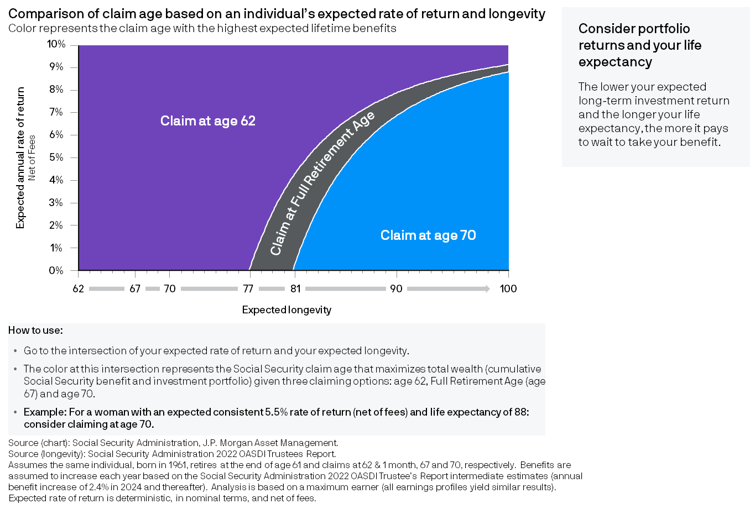
Social Security benefit claiming considerations
15
Retirement Landscape
Notes:
Waiting to claim a larger Social Security benefit may require that someone draw on an investment portfolio to meet lifestyle expenses until Social Security benefits are received. What rate of return would be high enough to make taking Social Security early at a reduced amount result in greater total lifetime value? This chart shows the Social Security claiming age that provides the greatest value based on a consistent rate of return net of fees (y axis) and expected longevity (x axis). Generally, the longer the life expectancy and the lower the expected return, the more it pays to wait to claim the benefit. For example, for a consistent return of 5.5% or less after fees, and expected longevity of age 88 or later, consider waiting to age 70 to claim if that is financially possible.

Slide 16
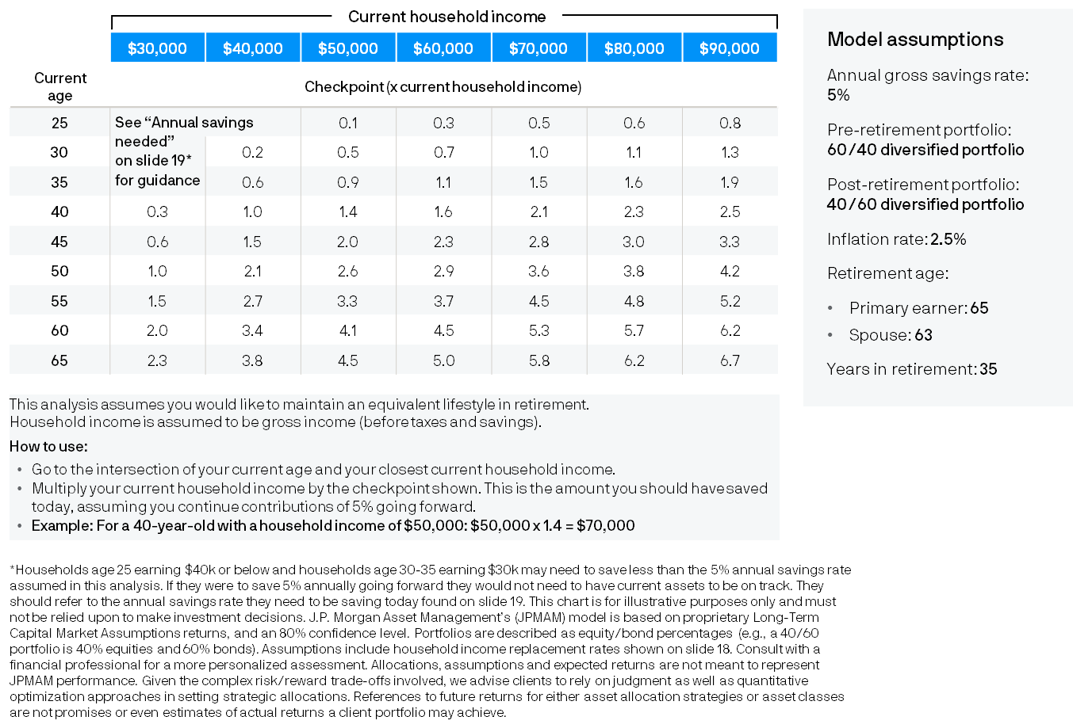
Retirement savings checkpoints
Household income ≤$90k
Annual savings rate: 5%
16
Saving
Notes:
Achieving a financially successful retirement requires consistent savings, disciplined investing and a plan, yet too few Americans have calculated what it will take to be able to retire at their current lifestyle. This chart (for household incomes ranging from $30,000 to $90,000) helps investors to quickly gauge whether they are “on track” to afford their current lifestyle for 35 years in retirement based on their current age and annual household income. This analysis uses an appropriate income replacement rate (detailed on slide 18), an estimate of how much Social Security is likely to cover and the rate of return and inflation rate assumptions detailed on the right to determine the amount of investable wealth needed today, assuming a 5% gross annual savings rate until retirement. It is important to note that this analysis assumes a household with a primary earner who plans to retire at age 65 when the spouse is assumed to be 63. If an investor’s current retirement savings falls short of the amount for their age and income, developing a written retirement plan tailored to their unique situation with the help of an experienced financial professional is a recommended next step. Households earning $40,000 or below who are age 25 and households earning $30,000 who are age 30-35 should refer to Slide 19 to see the annual savings targets for their situation which differ from the 5% annual savings rate assumed here.

Slide 17
Retirement savings checkpoints
Household income ≥$100k
Annual savings rate: 10%
17
Saving
Notes:
Achieving a financially successful retirement requires consistent savings, disciplined investing and a plan, yet too few Americans have calculated what it will take to be able to retire at their current lifestyle. This chart (for household incomes of $100,000 or more) helps investors to quickly gauge whether they are “on track” to afford their current lifestyle for 35 years in retirement based on their current age and annual household income. This analysis uses an appropriate income replacement rate (detailed on slide 18), an estimate of how much Social Security is likely to cover and the rate of return and inflation rate assumptions detailed on the right to determine the amount of investable wealth needed today, assuming a 10% gross annual savings rate until retirement. It is important to note that this analysis assumes a household with a primary earner who plans to retire at age 65 when the spouse is assumed to be 63. If an investor’s current retirement savings falls short of the amount for their age and income, developing a written retirement plan tailored to their unique situation with the help of an experienced financial professional is a recommended next step.

Slide 18
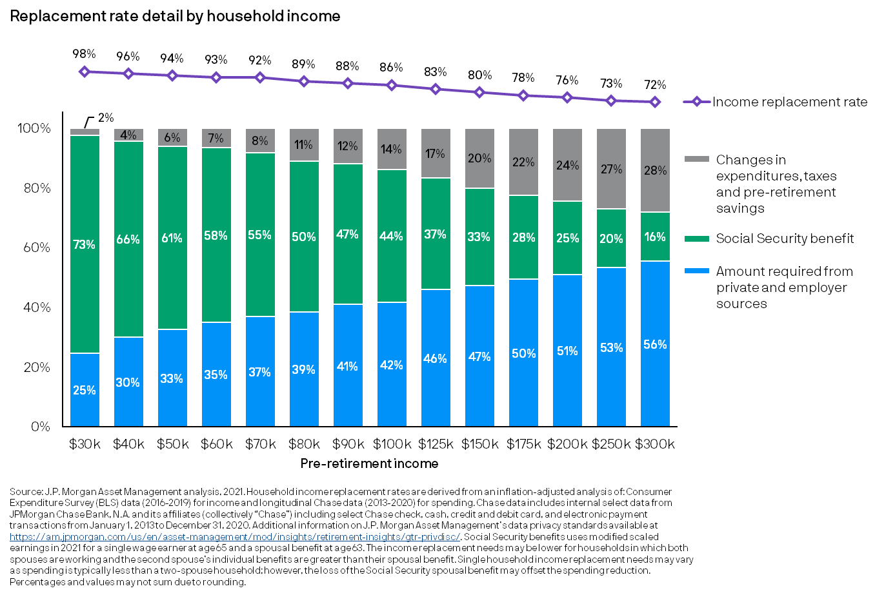
Income replacement needs vary by household income
18
Saving
Notes:
Income replacement needs vary by household income as people at different income levels have different pre-retirement savings, spending behaviors and income taxes. Based on J.P. Morgan research, this chart shows the percentage of pre-retirement income that may be needed to provide a comparable lifestyle at retirement. It also shows the breakdown of that total income by Social Security and people's own savings, which include employer-provided retirement plans, IRAs, mutual funds, annuities and other investments.

Slide 19
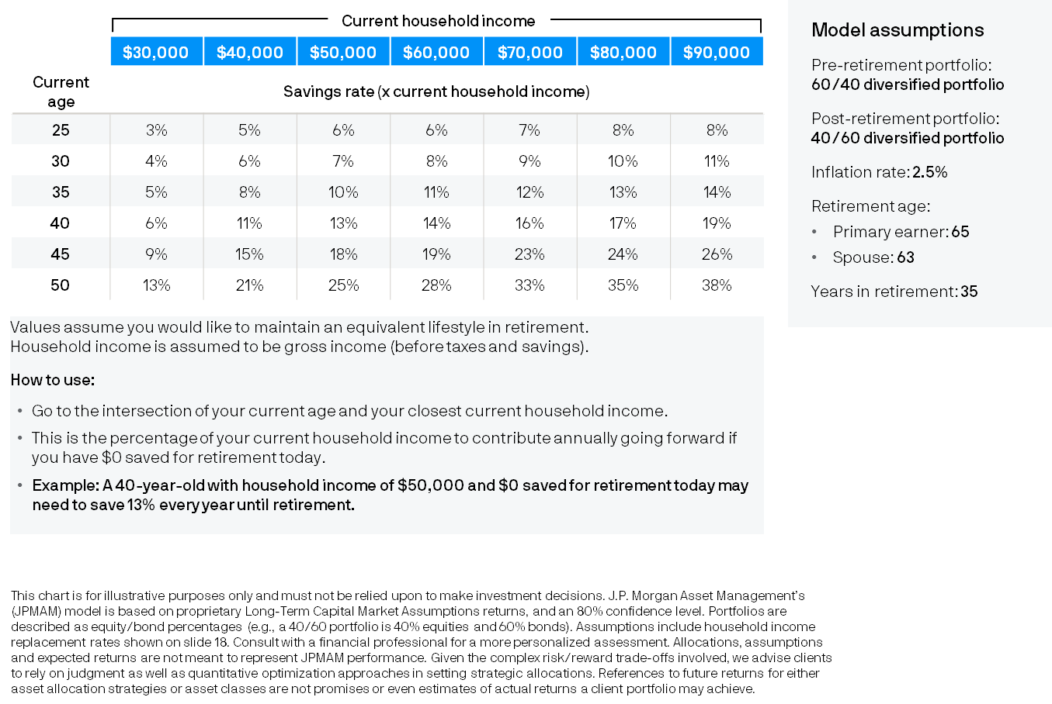
Annual savings needed if starting today
Household income ≤$90k
19
Saving
Notes:
How much should investors save for retirement? It depends on their unique circumstances: their income, the “lifestyle they have become accustomed to” and when they start saving. This chart shows the percentage of gross income that may need to be saved if starting at various ages shown in the left column. For a current 25-year-old with these levels of household income, the annual savings rate ranges from 3% to 8% – an achievable goal with prudent financial planning. By contrast, a current 50-year-old may need to save between 13% and 38% of gross income, a very unrealistic scenario for many. The sooner saving starts, the better the chances of achieving retirement success.

Slide 20
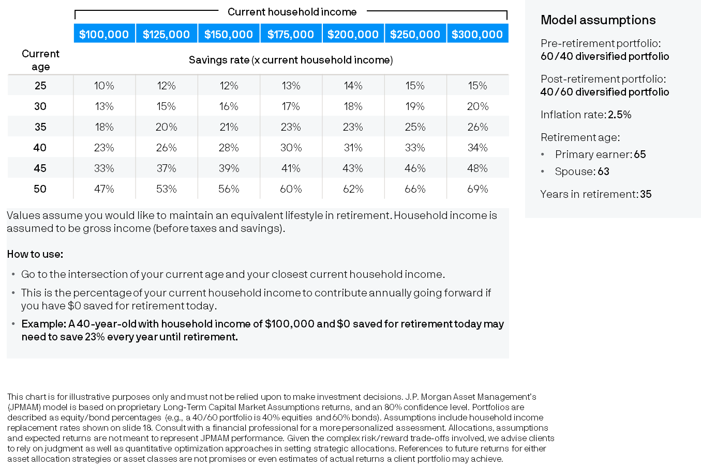
Annual savings needed if starting today
Household income ≥$100k
20
Saving
Notes:
How much should investors save for retirement? It depends on their unique circumstances: their income, the “lifestyle they have become accustomed to” and when they start saving. This chart shows the percentage of gross income that may need to be saved if starting at various ages shown in the left column. For a current 25-year-old with these levels of household income, the annual savings rate ranges from 10% to 15% – an achievable goal with prudent financial planning. By contrast, a current 50-year-old may need to save between 47% and 69% of gross income, a very unrealistic scenario for many. The sooner saving starts, the better the chances of achieving retirement success.

Slide 21
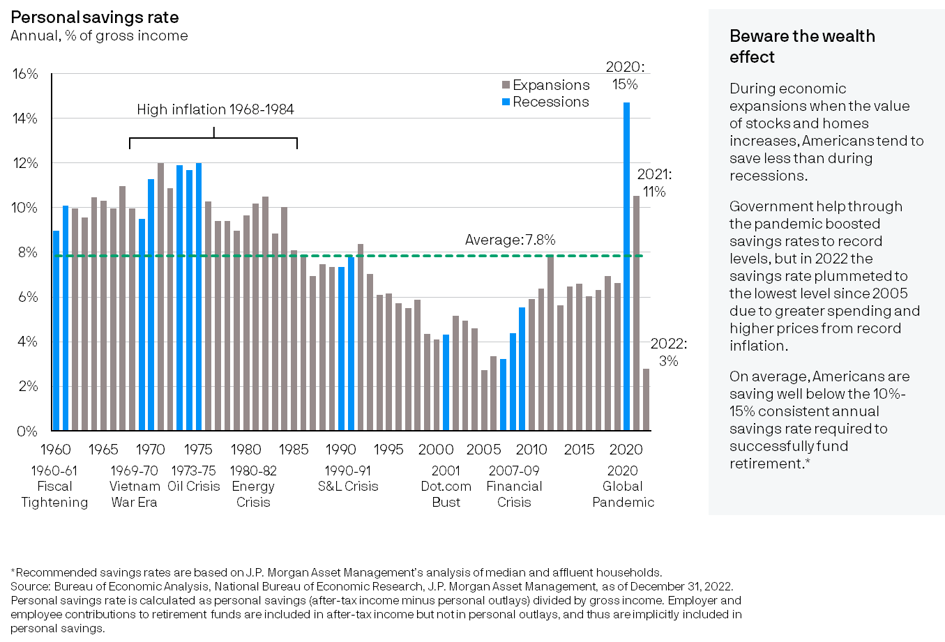
Historical annual savings rate
21
Saving
Notes:
This chart shows the average annual U.S. savings rate (including employer and employee contributions to retirement accounts) since 1960. In general, Americans save more during recessions and spend more during economic expansions. This is often referred to as the “Wealth Effect.” The long-term average of almost 8% is well below the recommended retirement savings rate of 10% to 15%. 2020 and 2021 saw record savings of 15% and 11% respectively due to several factors associated with the Global Pandemic (e.g., fiscal stimulus, stay at home orders, etc.). However, in 2022, the savings rate plummeted to 3%, the lowest level since 2005 due to greater spending and higher prices from record inflation. It is important to note that this savings rate is not evenly distributed – higher income households tend to save much more than lower income households.

Slide 22
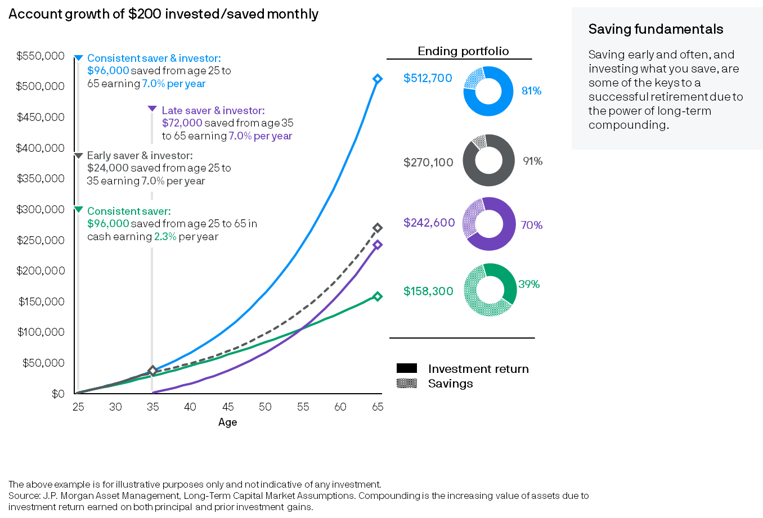
Benefit of saving and investing early
22
Saving
Notes:
Saving and investing early and consistently over a long time is important to retirement success. This chart compares different retirement outcomes based on various saving and investing behaviors of four hypothetical people who save the same amount per month but at different times in their lives, for different durations and with different investment choices. The consistent saver & investor reaches age 65 with substantially more than the other savers. The early saver & investor saved only one third of the amount of the late saver & investor, but because of the power of long-term compounding on money invested early helped the early saver to accumulate more savings than the late saver. Consistent saver in green saves as much and as often as the investor at the top in blue but keeps his savings in cash rather than investing it. As a result, he accumulates about a third of the consistent saver & investor’s final amount.

Slide 23
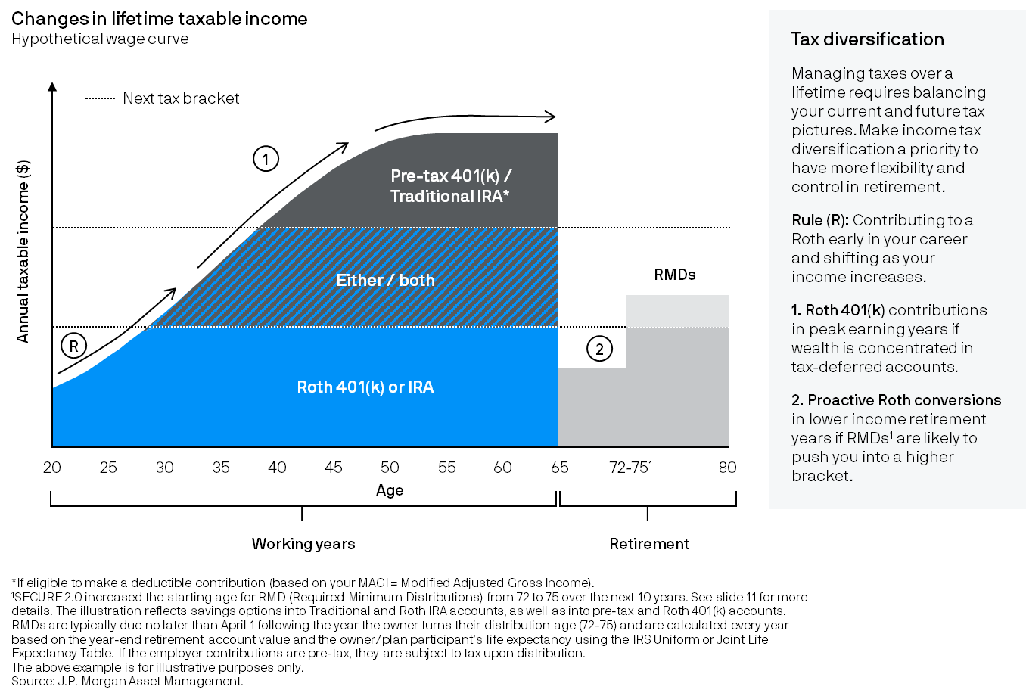
Evaluate a Roth at different life stages
23
Saving
Notes:
The decision to make a pre-tax/deductible contribution to a Traditional 401(k) or IRA or an after-tax contribution to a Roth 401(k) or Roth IRA is based on the income tax rate of the individual at the time of the contribution, and the anticipated tax rate in the future when withdrawals are taken. The difference in tax rates can be caused by an investor’s personal situation and/or tax policy over time. This chart shows a typical wage curve and the general “rule of thumb” about what type of contribution may be most appropriate based on current income and the anticipated bracket in retirement. An additional consideration is to maintain a healthy mix of taxable, tax-free (Roth) and tax-deferred accounts to provide greater flexibility and control when managing income taxes over time. The numbers on the chart specify situations in which contributing or converting to a Roth option should be carefully considered.

Slide 24
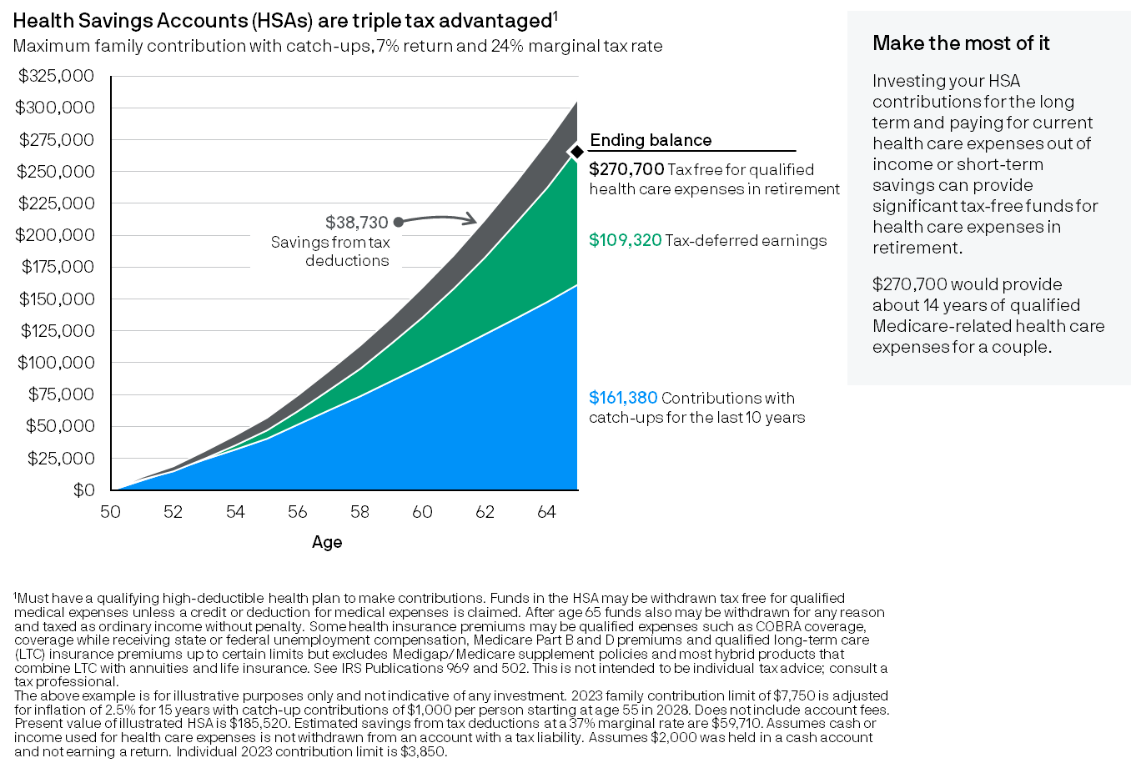
Maximizing an HSA for health care expenses
24
Saving
Notes:
Health Savings Accounts are triple-tax free, so if eligible to contribute, make the most of it. Tax advantages include tax-free or tax-deductible contributions, tax-deferred earnings in the account and tax-free withdrawals for qualified health care expenses. If HSA dollars are invested, the earnings inside the account may be significant. The best chance to benefit from long-term tax-deferred compounding is the result of paying for current health care expenses from funds outside of the HSA to the extent feasible. This approach can maximize all three tax-advantaged aspects of an HSA to help cover qualified health care expenses in retirement. While HSAs are tax-advantaged accounts, there are tax penalties for withdrawals that are not qualified before the age of 65; therefore, it is important to have a separate emergency savings account. See IRS publications 502 and 969 for details on qualified withdrawals.

Slide 25
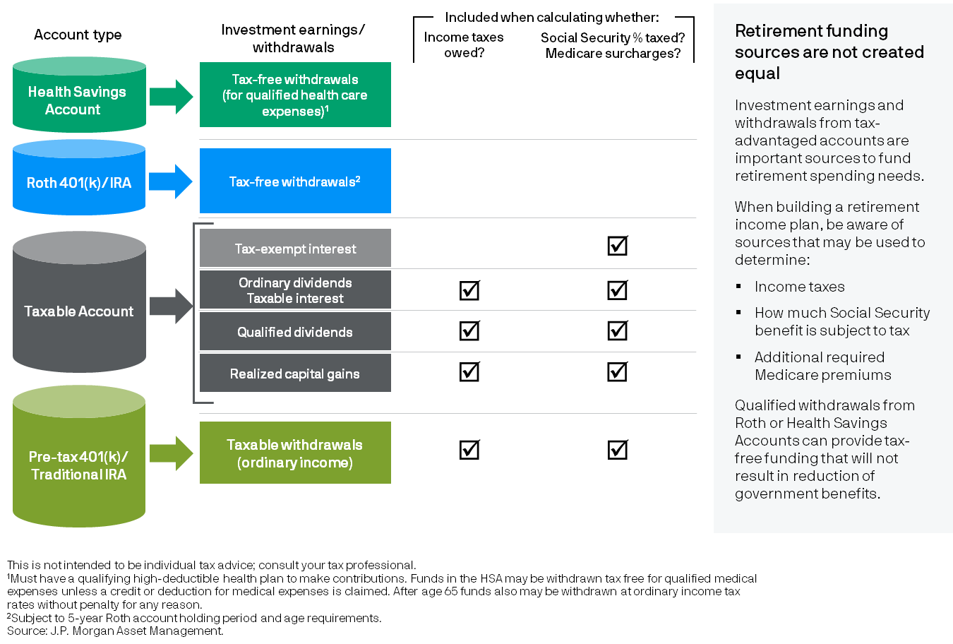
Diversified sources of retirement funding
25
Spending
Notes:
When saving for retirement, it is important to be well diversified from tax perspective because once in retirement, drawing from various account types to fund spending needs may impact not only the income taxes owed, but how much Social Security may be subject to income taxes and/or Medicare surcharges owed. Currently, qualified withdrawals from Roth and Health Savings accounts are tax-free and are not included in Social Security taxation or Medicare surcharge requirements. As a result, they are a nice compliment to taxable and tax-deferred accounts because they can provide greater flexibility and control during retirement.

Slide 26
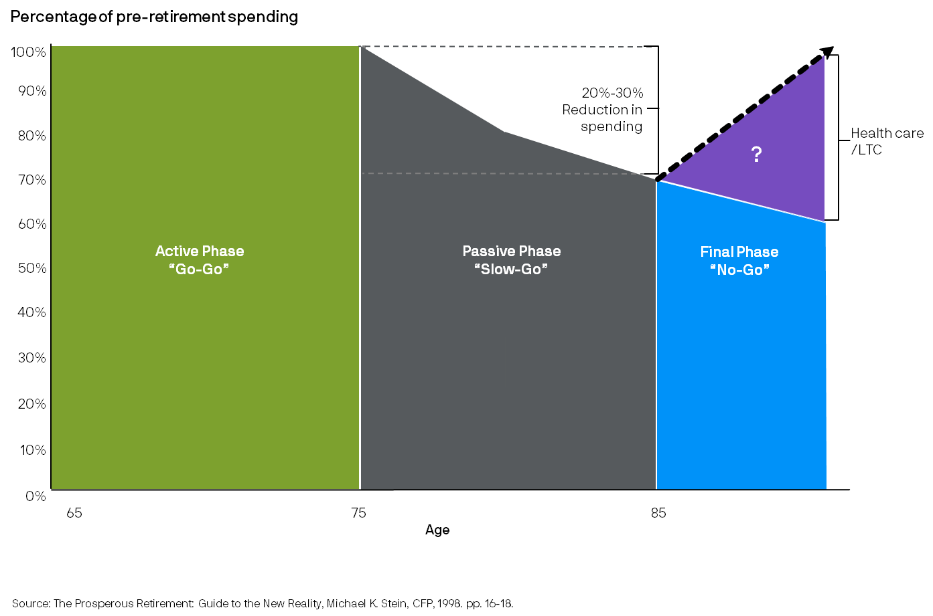
“The Prosperous Retirement”: theoretical spending profile
26
Spending
Notes:
Retirement is typically comprised of several phases. The "Prosperous Retirement" profile (coined by advisor Michael Stein) is an anecdotal illustration of what many experience. The first decade or more in retirement can be quite active resulting in spending at or greater than was spent pre-retirement. This 'Active' phase is important to maximize as long as good health, the freedom of new-found time and a 'bucket' list persist. This phase gives way to a more passive or 'Slow-Go' phase when spending tends to decline in real terms. The 'Final Phase' sees lifestyle spending continue to decline while health care and long-term care expenses may rise significantly. Recognizing these 'phases' can help individuals craft a retirement income and spending plan aligned to how they are likely to spend their time while planning for key risks later in retirement.

Slide 27
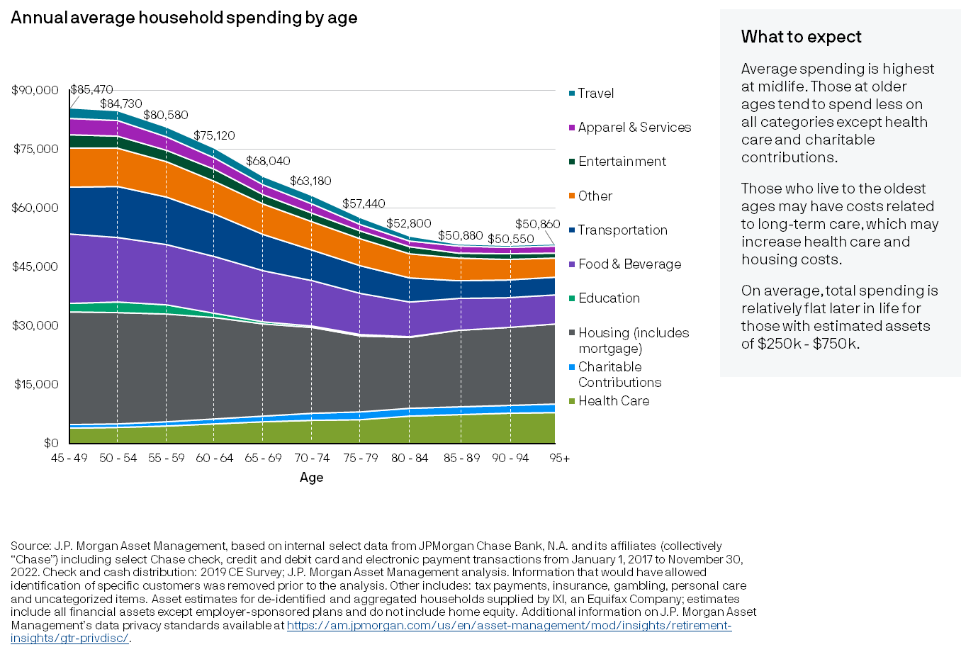
Changes in spending
All households
$250k - $750k investable wealth
27
Spending
Notes:
This chart illustrates what households with estimated wealth of $250k - $750k spend on different categories at specific ages. Most Americans’ peak spending years are at midlife, and thereafter spending tends to trend downward, until it flattens out again at the oldest ages, on average. The largest expenditure category at all ages is housing, while the category that older people spend significantly more on than younger people is health care. Housing and health care may increase late in life due to the possibility of needing long-term care.

Slide 28
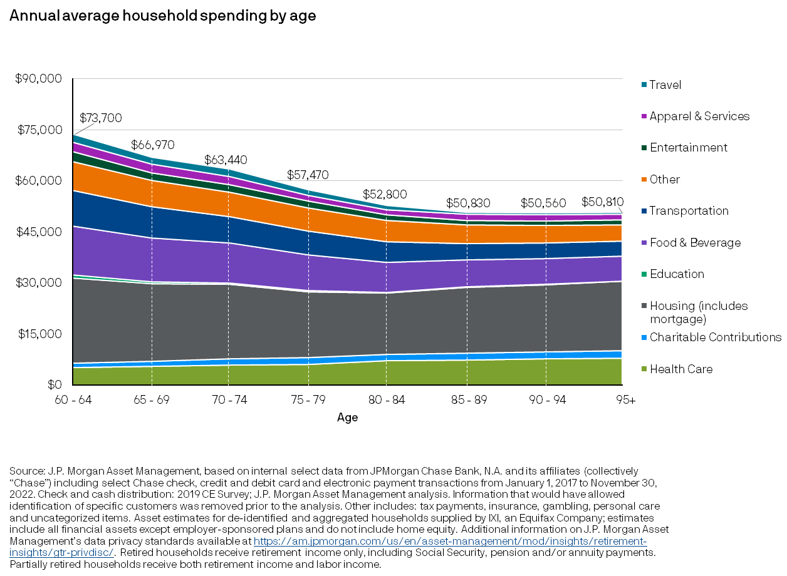
Changes in spending
Partially and fully retired households
$250k - $750k investable wealth
28
Spending
Notes:
This chart illustrates what households who are partially and fully retired with estimated wealth of $250k - $750k spend on different categories at specific ages. The trend is similar to all households, but the reduction in spending is slightly less steep since some of the spending reduction may have taken place prior to receipt of retirement income for some households. Partially retired households have a mix of income from work and retirement income. Retirement income is Social Security, pensions and annuity payments.

Slide 29
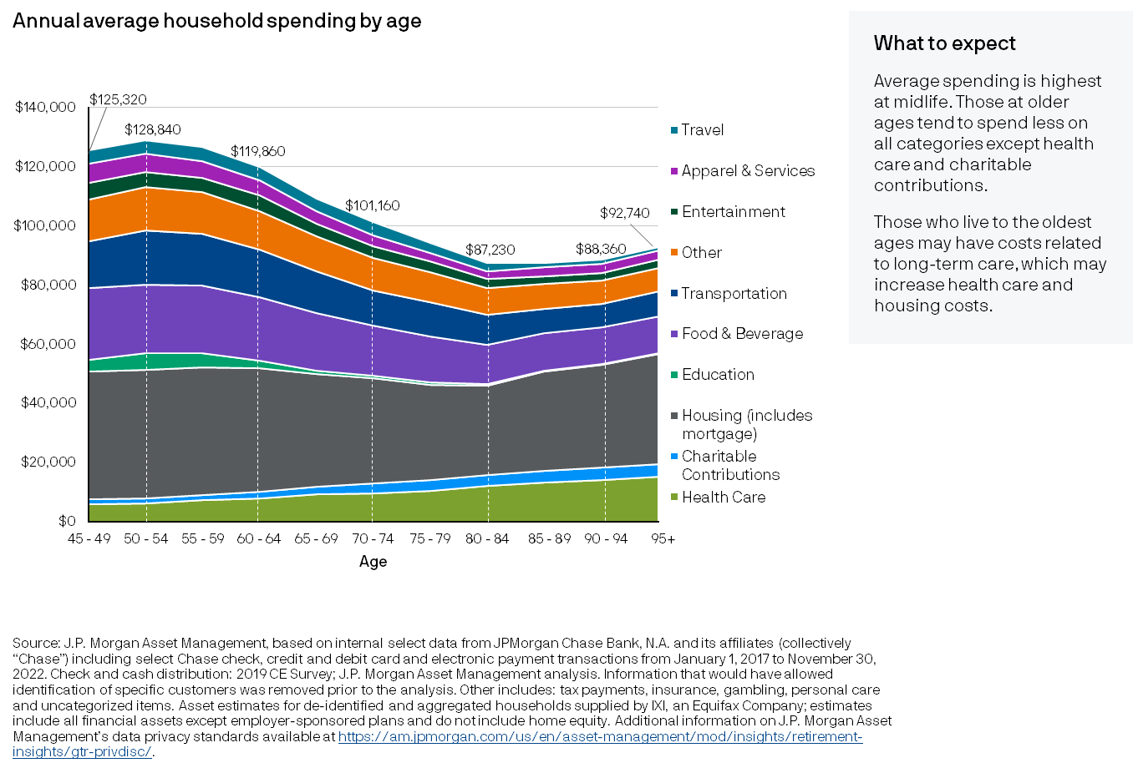
Changes in spending
All households
$1m - $3m investable wealth
29
Spending
Notes:
This chart illustrates what households with estimated wealth of $1m - $3m spend on different categories at specific ages. Most Americans’ peak spending years are at midlife, and thereafter spending tends to trend downward, until it trends up again towards up again at the oldest ages. The largest expenditure category at all ages is housing, while the category that older people spend significantly more on than younger people is health care. Housing and health care may increase late in life due to the possibility of needing long-term care.

Slide 30
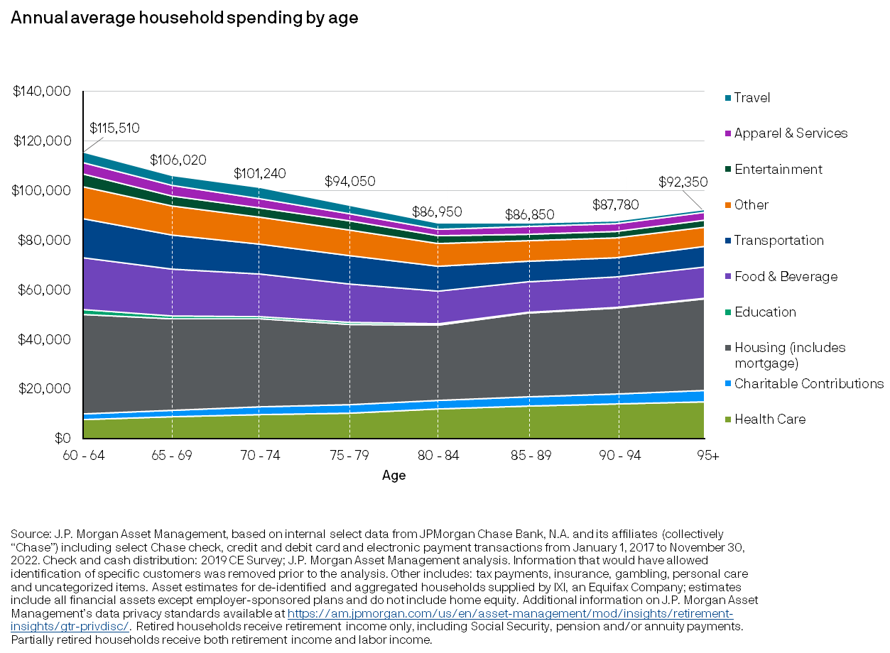
Changes in spending
Partially and fully retired households
$1m - $3m investable wealth
30
Spending
Notes:
This chart illustrates what households who are partially and fully retired with estimated wealth of $1m - $3m spend on different categories at specific ages. The trend is similar to all households, but the reduction in spending is slightly less steep since some of the spending reduction may have taken place prior to receipt of retirement income for some households. Partially retired households have a mix of income from work and retirement income. Retirement income is Social Security, pensions and annuity payments.

Slide 31
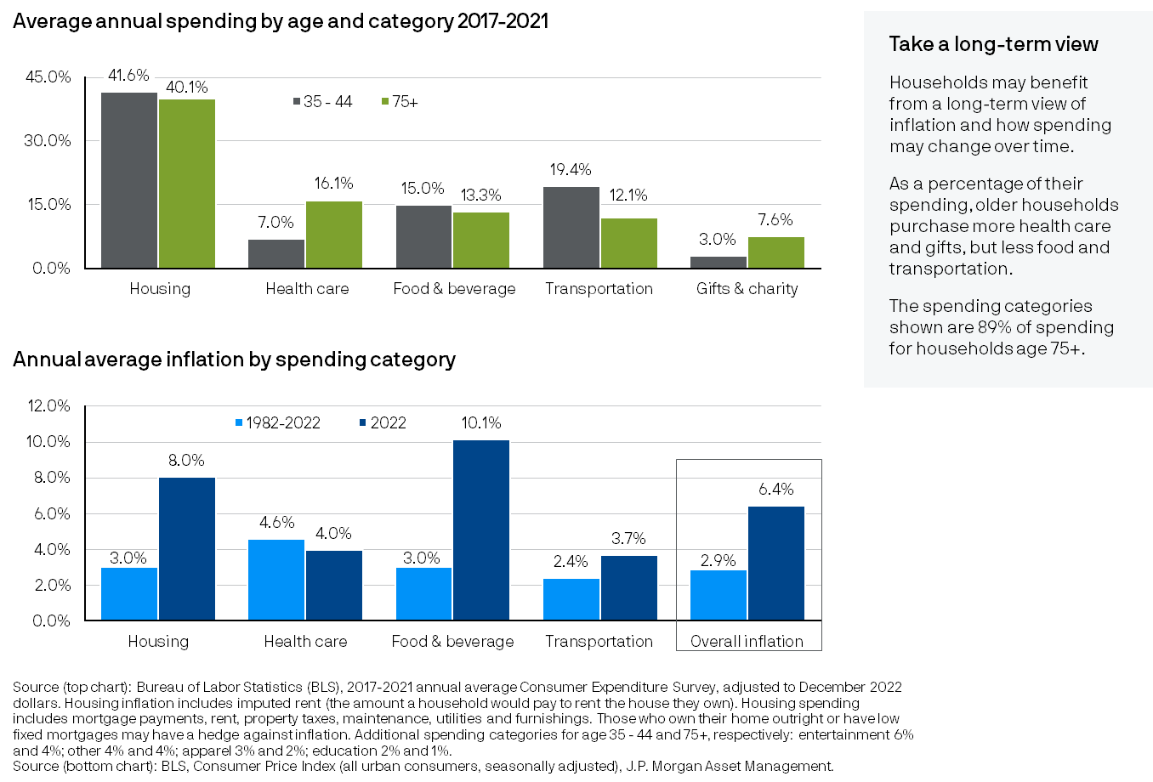
Spending and inflation
31
Spending
Notes:
During periods of higher inflation, it is important to consider long-term inflation used in retirement planning forecasts. Different categories of spending inflate differently, and households spend very differently at different ages. Therefore, households do not experience inflation to the same degree. Older households need to plan for high health care inflation, including the fact that they will likely use more health care goods and services as they get older. For some retirees, housing inflation may not be as much of an issue if they own their home outright since housing inflation includes imputed rent, which is the amount that it would cost to rent their home if they did not own it. And while all households are affected by food and beverage inflation, those age 75+ spend a smaller share of their budget on it than younger households.

Slide 32
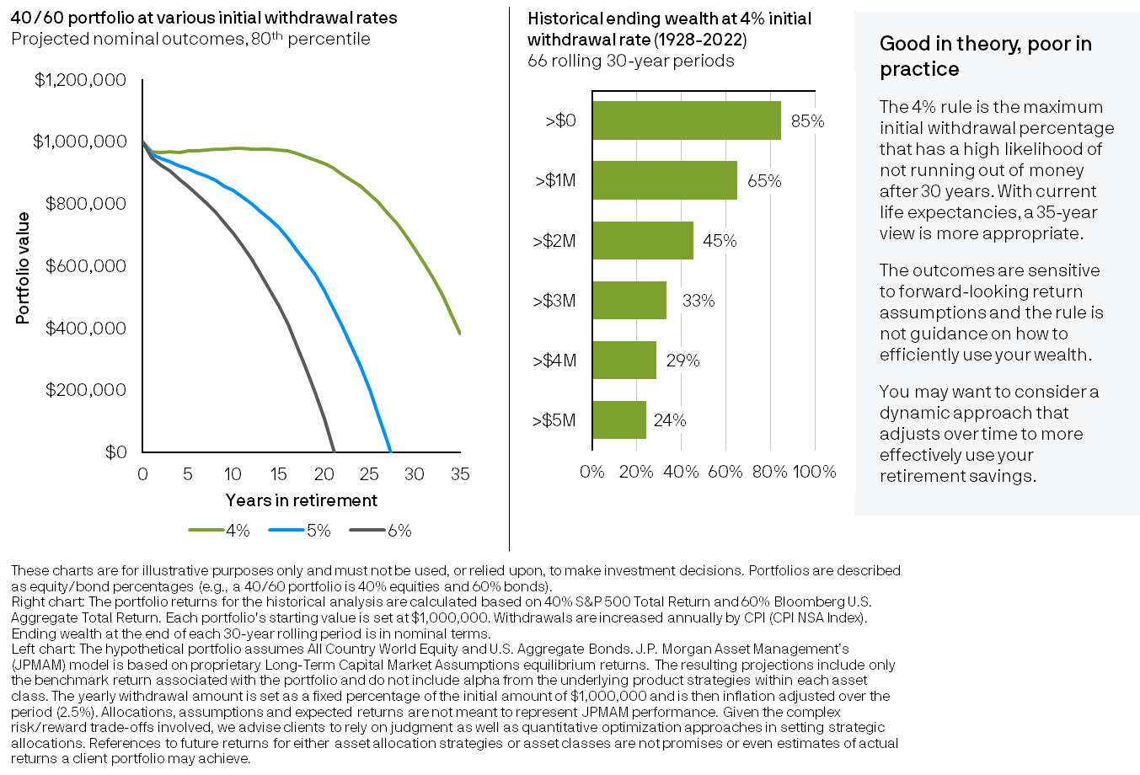
The 4% rule: projected outcomes vs. historical experience
32
Spending
Notes:
Based on J.P. Morgan’s 2023 Long-Term Capital Market Assumptions and assuming an 80% confidence level and a 40% equity, 60% bond portfolio, the 4% initial withdrawal rate continues to be a successful level of spending that avoids running out of money before 30 years have passed. But the results are highly sensitive to when one decides to retire and market performances they experience. How has the 4% rule performed in the past? Based on an analysis of 66 rolling 30-year historical periods from 1928-2022, 1 in 4 times investors may have had 5 times the amount that they started with at the end of retirement. This may be a positive outcome if an investor’s goal is to leave a legacy. It may be a poor outcome if lifestyle sacrifices were made along the way to keep spending low relative to how the portfolio was performing over time. The 4% rule is a helpful rule of thumb to understand the maximum withdrawal rate that has a very high confidence of not running out of money – it is not an efficient withdrawal plan for households that want to use their retirement wealth to support their retirement lifestyle.

Slide 33
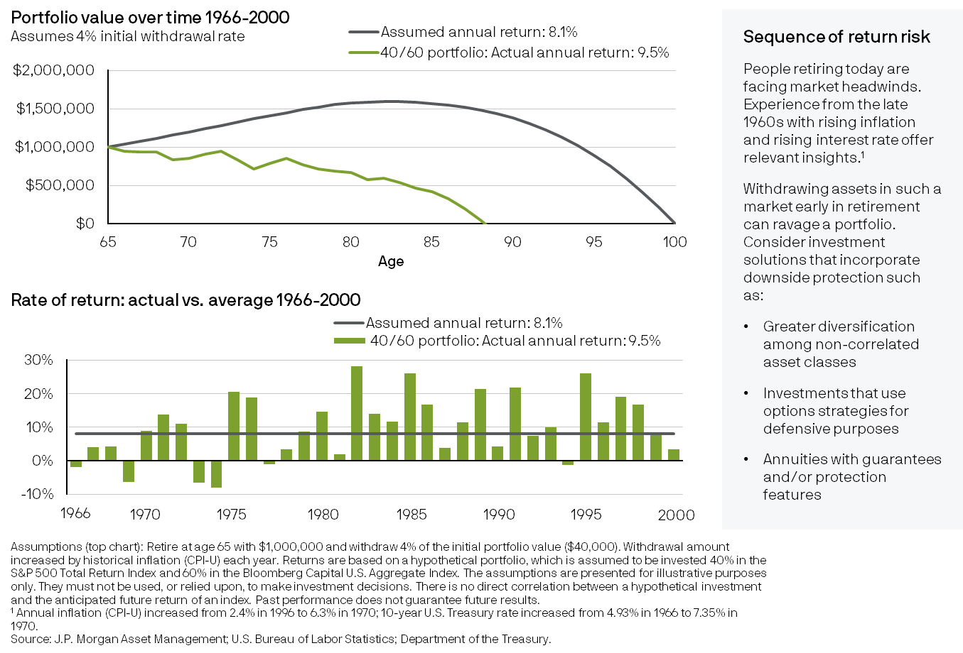
Dollar cost ravaging: timing risk of withdrawals
33
Spending
Notes:
Retirement timing risk is when an investor retires at the beginning of a declining or bear market. This subjects a portfolio to sequence of return risk, which is poor market returns at the beginning of retirement. This may have a significant impact on outcomes. The bottom chart shows the returns experienced from 1966 to 2000, with below average and negative returns in many of the first 10 years resulting in the accelerated depletion of assets by the age of 89. Investment solutions that can help mitigate this risk include greater diversification among non-correlated asset classes, investments that use options strategies for defensive purposes and annuities with guarantees and/or protection features.

Slide 34
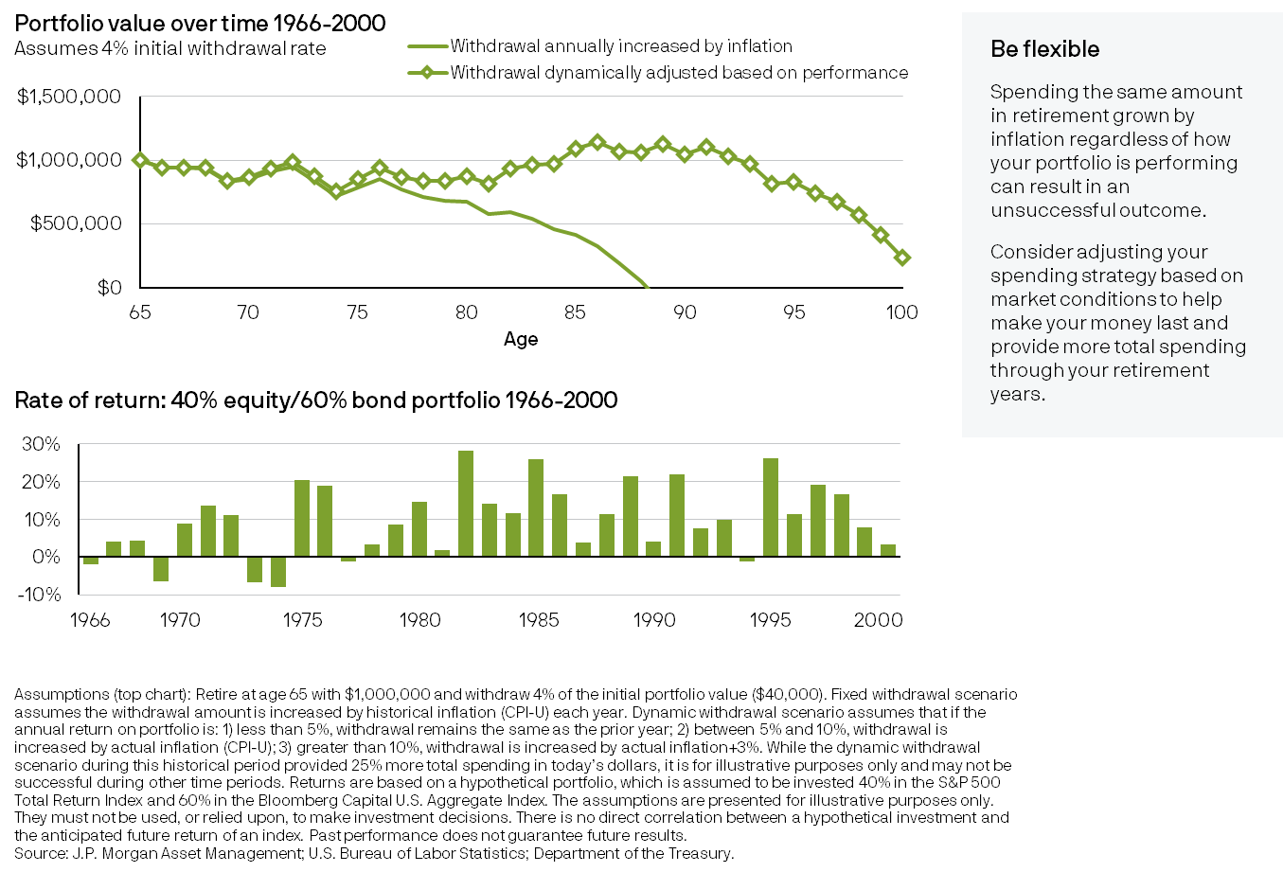
Mitigating dollar cost ravaging: dynamic spending
34
Spending
Notes:
Dollar cost ravaging can occur if households experience poor returns early in retirement, just as they are beginning to spend their retirement portfolio. The bottom chart shows the sequence of returns experienced by a 40% equity and 60% bond portfolio from 1966 to 2000. During that time period, below average and negative returns were experienced in many of the first 10 years. The top chart shows the outcome of two spending scenarios. The smooth green line represents the portfolio value assuming that the household withdraws 4% of their initial portfolio and increases each year’s withdrawal by inflation, regardless of how their portfolio performs. The green line with squares illustrates a dynamic spending strategy in which the household grows their withdrawal by inflation in periods of normal returns. They do not give themselves a raise after a year of poor market returns and give themselves a little more of a raise after a year of outperformance. By adapting their spending based on how their portfolio is performing, the household is able to meet their lifetime spending needs with a buffer remaining at age 100, and spend about 25% more in total in today’s dollars.

Slide 35
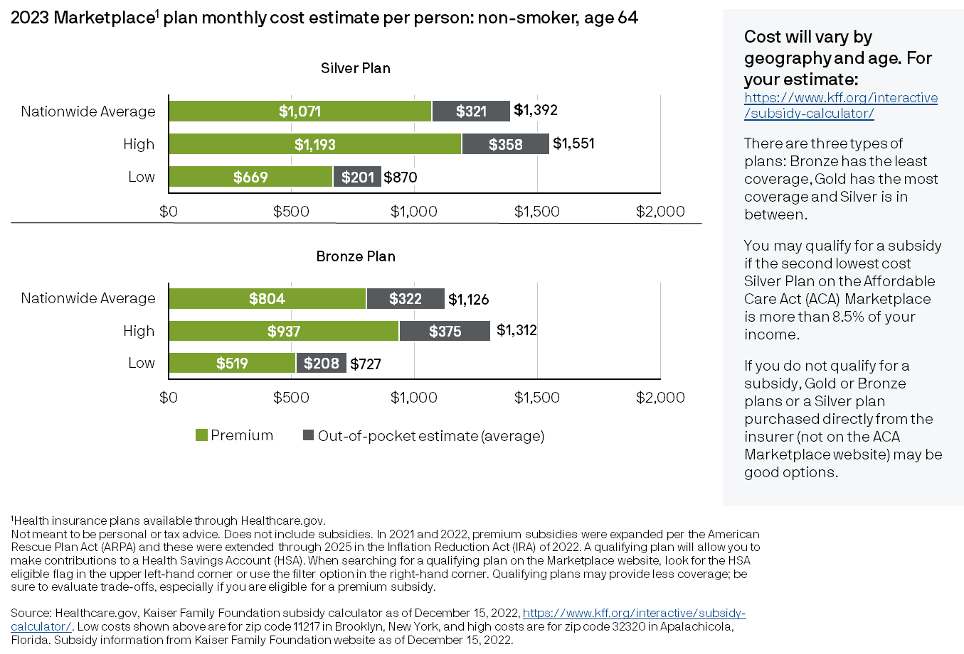
Health care costs for retirees before age 65
35
Spending
Notes:
Most Americans retire prior to being eligible for Medicare coverage (age 65). If they do not have access to an employer-provided plan through a spouse, they may need to purchase coverage through the Healthcare Insurance Marketplace (via healthcare.gov). This chart shows the wide variation in health care costs available through the marketplace. To get an estimate for a specific situation, go to the Kaiser Family Foundation subsidy calculator. The calculator will also provide information on potential subsidy and tax credits. Subsides are enhanced through 2025, so they may be reduced after that. For those who are ineligible for subsidies, it is more important to compare plan types and check pricing for Silver Plans directly from an insurer.

Slide 36
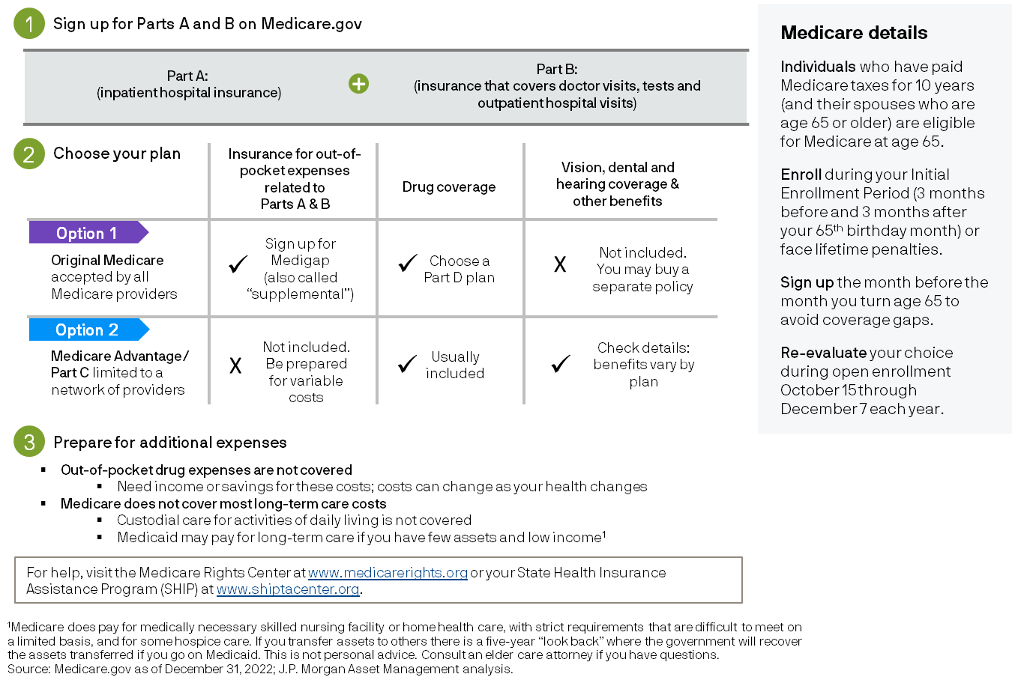
Three steps for Medicare coverage
36
Spending
Notes:
This chart shows the three steps for Medicare coverage, starting with signing up for Parts A and B on Medicare.gov. Step 2 is choosing a plan: Original Medicare or Medicare Advantage. The charts show what is available for each option; there are pros and cons that should be carefully reviewed. Step 3 is preparing for additional expenses that aren’t covered by Medicare. Be sure to sign up as soon as possible to avoid coverage gaps and reevaluate each year during open enrollment. For more information, go to Medicarerights.org or shiptacenter.org.

Slide 37
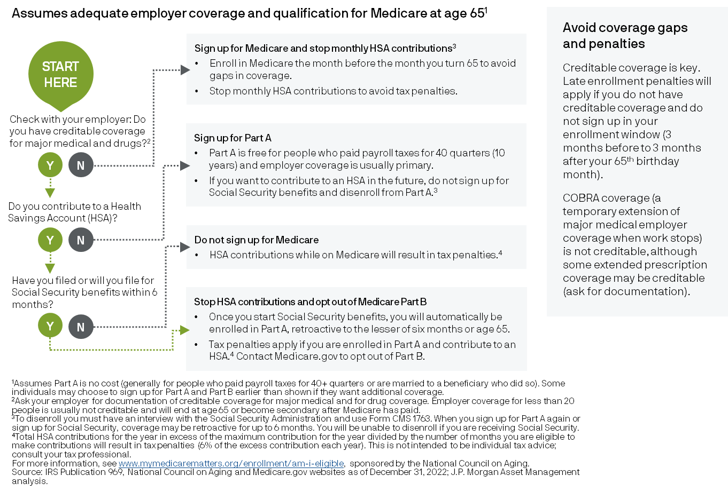
65 and working: should I sign up for Medicare?
37
Spending
Notes:
This flow chart may help individuals who are still working at age 65 or older decide if they should sign up for Medicare and/or continue to contribute to a qualified Health Savings Account. Considerations are different for those who work for employers with 20 or more employees versus those who work for smaller employers as well as those who are taking Social Security benefits. One of the most important things to know is if someone has creditable coverage, including creditable drug coverage. If not, and they sign up later, they may face lifelong penalties. There also may be severe tax consequences for those contributing to an HSA while receiving Medicare Part A, and Part A coverage is mandatory and retroactive for 6 months before they signed up for Social Security benefits or age 65, whichever is later.

Slide 38
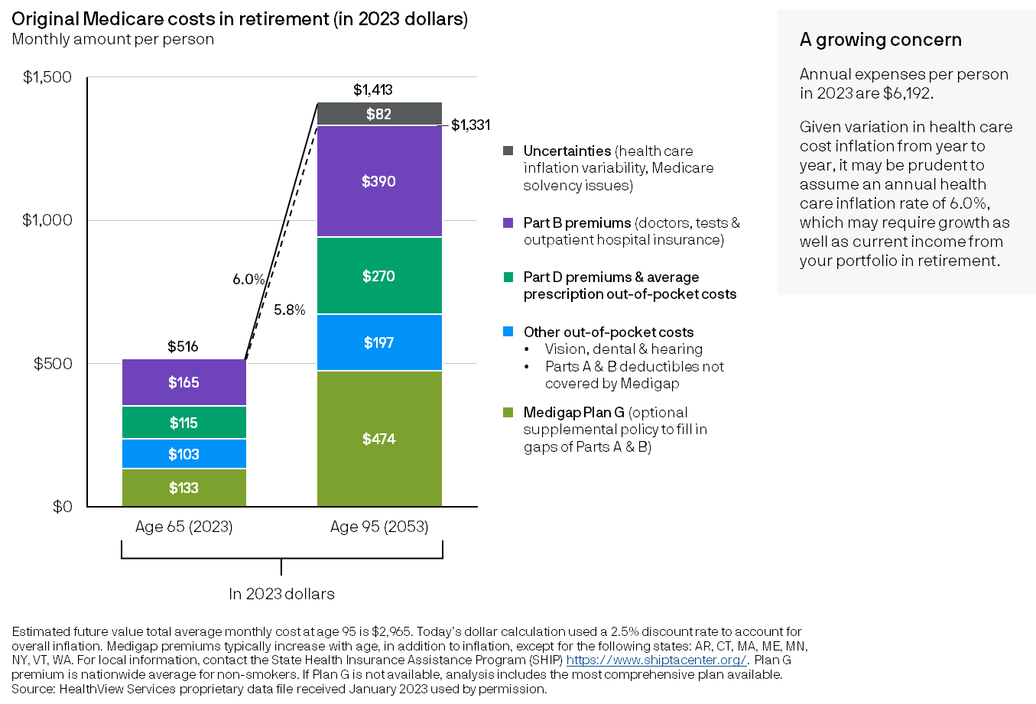
Rising health care costs in retirement
38
Spending
Notes:
This chart illustrates total Medicare-related health care costs experienced by today’s 65-year-old with original Medicare, and how those costs may increase over time. Costs include Medigap, which is a supplemental policy that covers co-pays and deductibles for Parts A and B. Medigap plans are standardized, with Plan G being the most comprehensive available for most new beneficiaries. Part D for prescription drugs coverage and prescription out-of-pocket expenses are also included. Average costs are about $516 per month or about $6,192 per person annually. These costs are projected to more than triple over 30 years in today’s dollars for three reasons: 1) higher than average inflation for health care expenses; 2) increased use of health care at older ages; and 3) Medigap premiums that increase not only with inflation but also due to increased age in most states. These costs do not include most long-term care expenses.

Slide 39
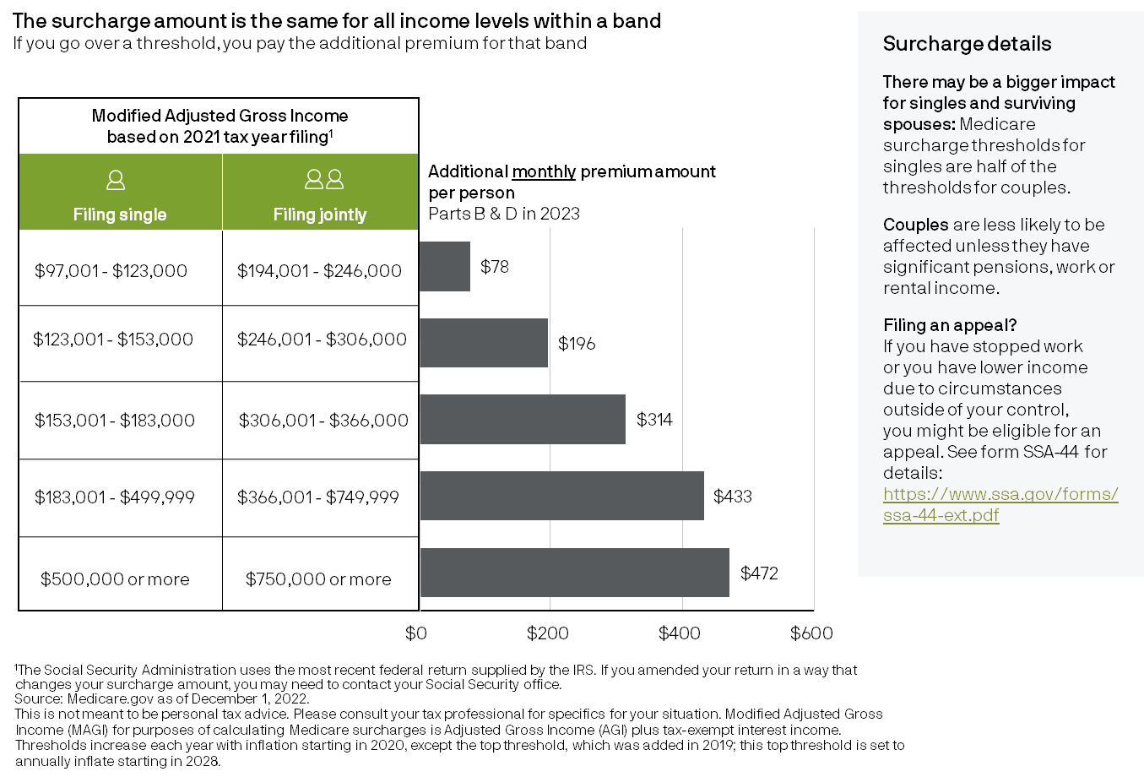
2023 monthly Medicare surcharges
39
Spending
Notes:
For both original Medicare and Medicare Advantage, Part B and D premiums will be higher for those with Modified Adjusted Gross Income (MAGI) over $97,000 if filing single or $194,000 if filing jointly. The latest tax return is used to calculate the surcharge; this is usually the tax return from 2 years prior. If an individual has stopped working or has reduced income due to circumstances outside of their control, they may be eligible for an appeal. This is not meant to be personal tax advice. Please consult with a tax professional.

Slide 40
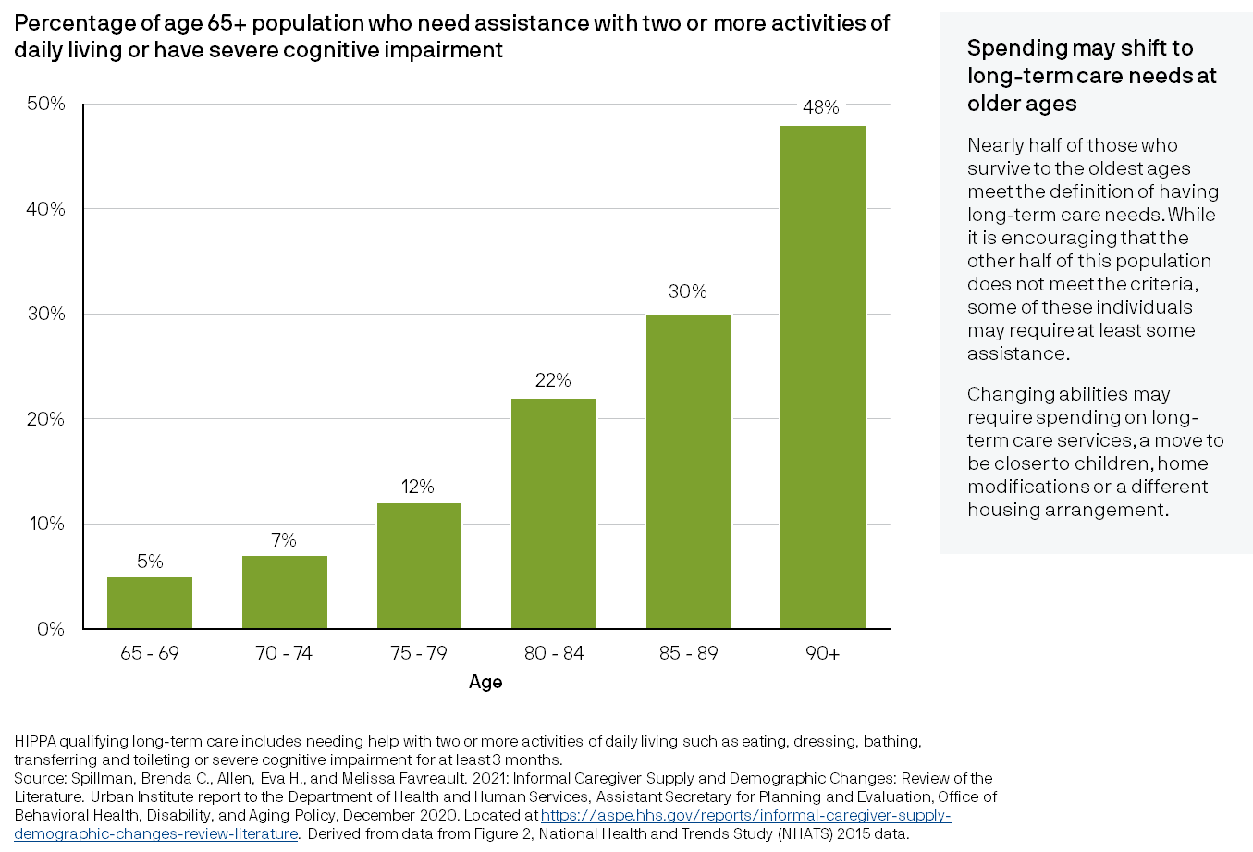
Disability incidence increases with age
40
Spending
Notes:
Those who survive to the oldest ages have an almost even chance of needing assistance due to inability to perform two or more activities of daily living or severe cognitive impairment. The odds of needing help go up well before then, with one in five 80 – 84 year-olds requiring assistance. As individuals age, changing abilities may require a move, home modifications and/or paying for help, which could increase spending late in life.

Slide 41
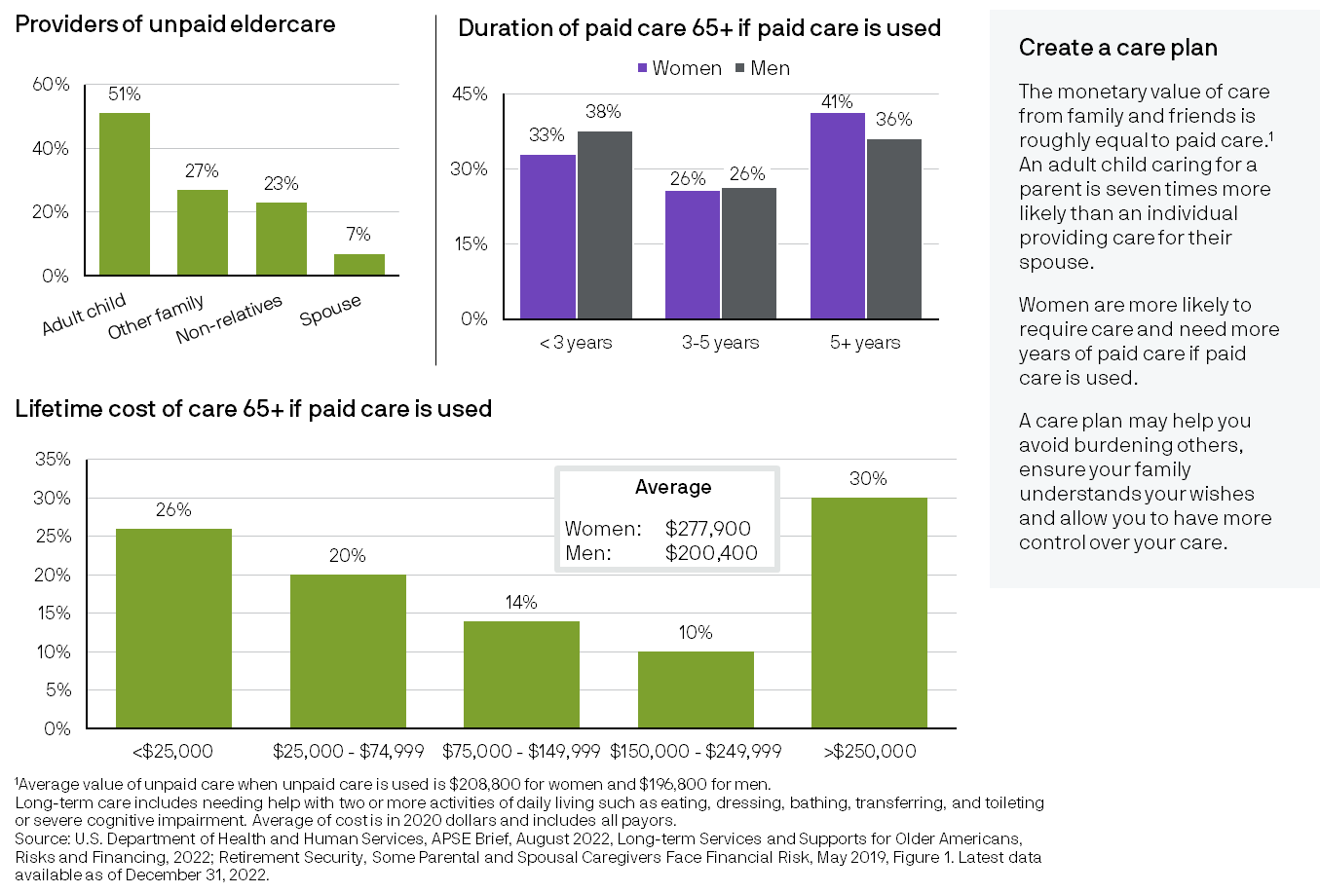
Long-term care planning
41
Spending
Notes:
Family members and friends often provide unpaid eldercare – and it is surprising how often that is adult children. There may be a progression of care from one type to another. Duration of care varies but 36% of men and 41% of women who use paid care use it for 5 years or more. The lifetime cost of care to all payors including insurance, government sources and private payors averages $277,900 for women and $200,400 for men, although there is a wide range, with many paying less or more than the average. One of the reasons that women may require more care is they generally live longer than men. For all individuals, these statistics highlight the need for a care plan.

Slide 42
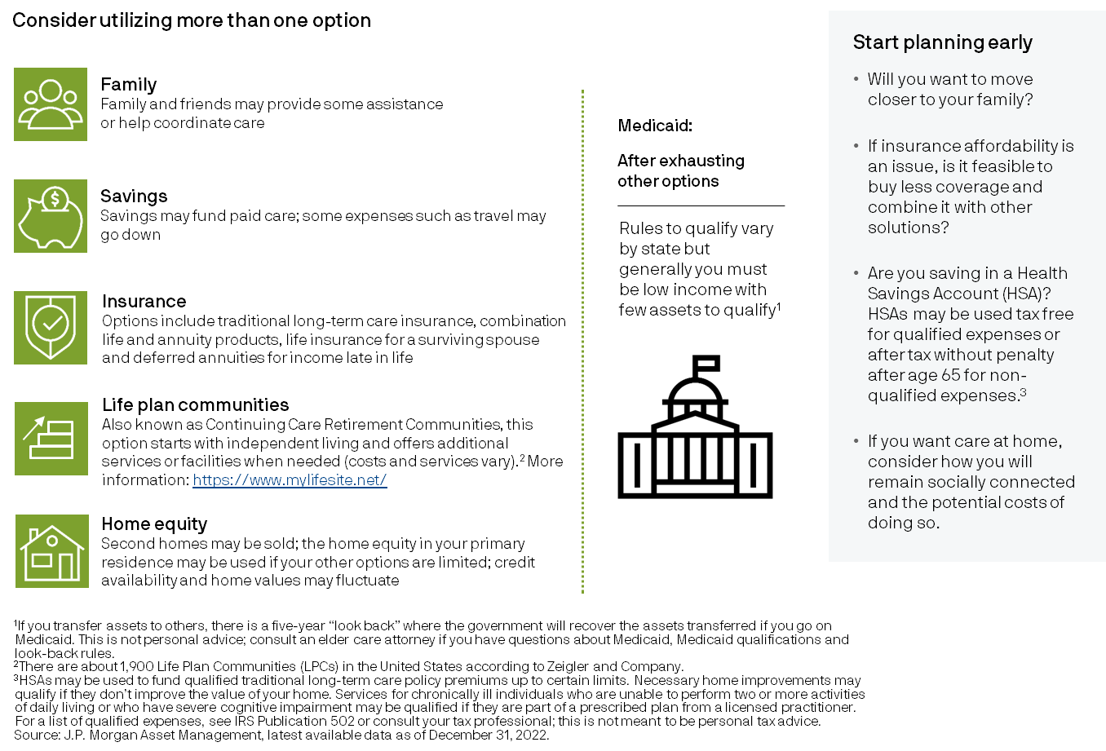
Long-term care planning options
42
Spending
Notes:
When planning for long-term care, consider multiple options, including family assistance, income, savings, home equity, life insurance for a surviving spouse and other insurance options that range from traditional long-term care insurance to combination products to annuities. Life Plan Communities are also a possibility for those who can afford them, and some individuals use the proceeds from their home sale to finance the fees. Types of life plan communities vary – see MyLifeSite.net for more information. Medicaid may be a last resort; and if Medicaid is utilized, individuals may have less control over the type of care and care setting. For specifics regarding Medicaid qualification, consult with an elder care attorney with familiarity with the laws in your state.

Slide 43
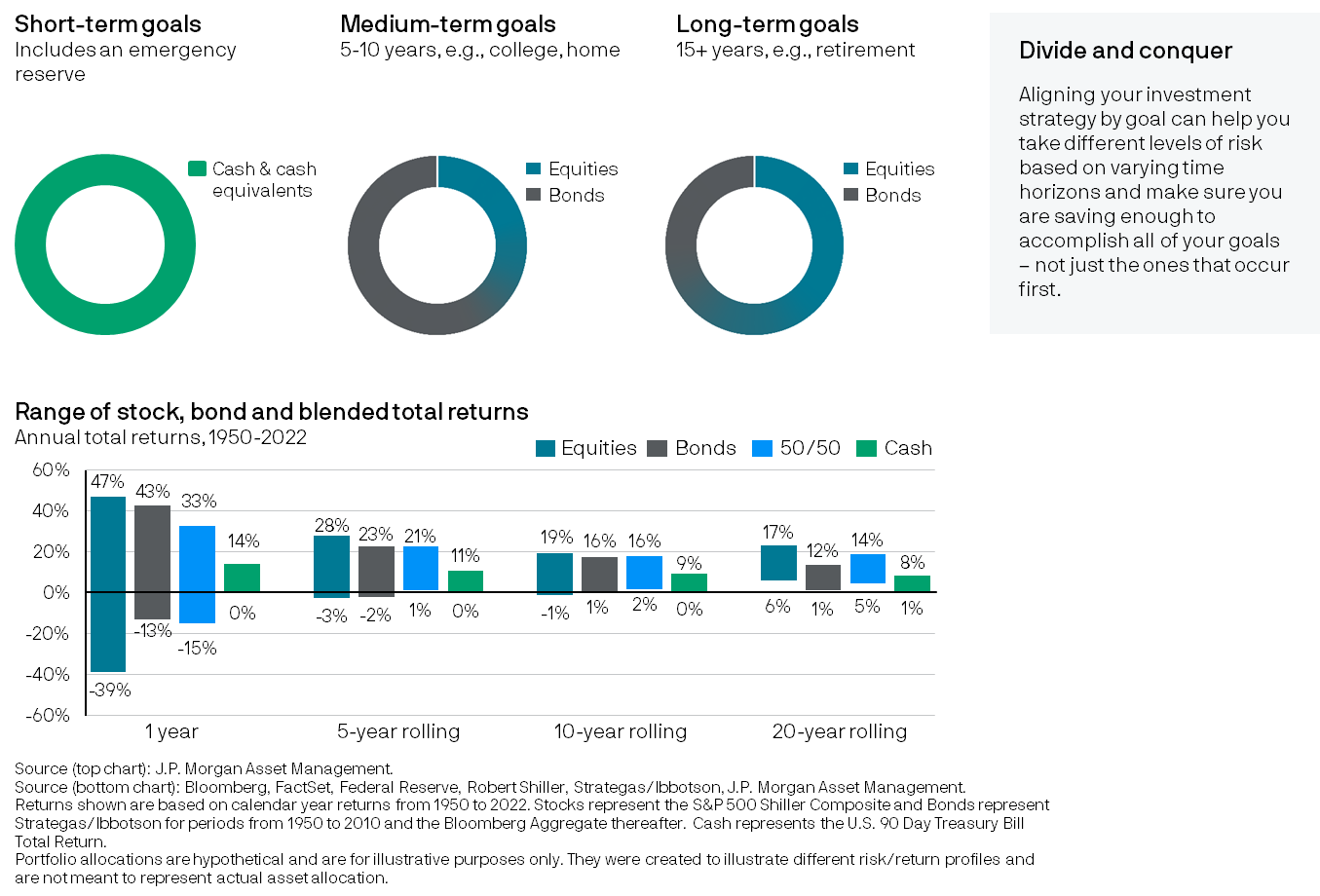
Goals-based wealth management
43
Investing
Notes:
Achieving multiple goals with varying time horizons and savings requirements can be challenging if wealth and savings are grouped all together. For greater clarity and control, consider using a goals-based wealth management approach in which assets are invested according to the time horizon of major goals, and the savings required to achieve each goal is determined and managed on an individual basis. This goals-based approach is only successful if there is an emergency reserve big enough to fund spending and income shocks throughout the year. See slide 49 for more detail on how large the reserve may need to be.

Slide 44
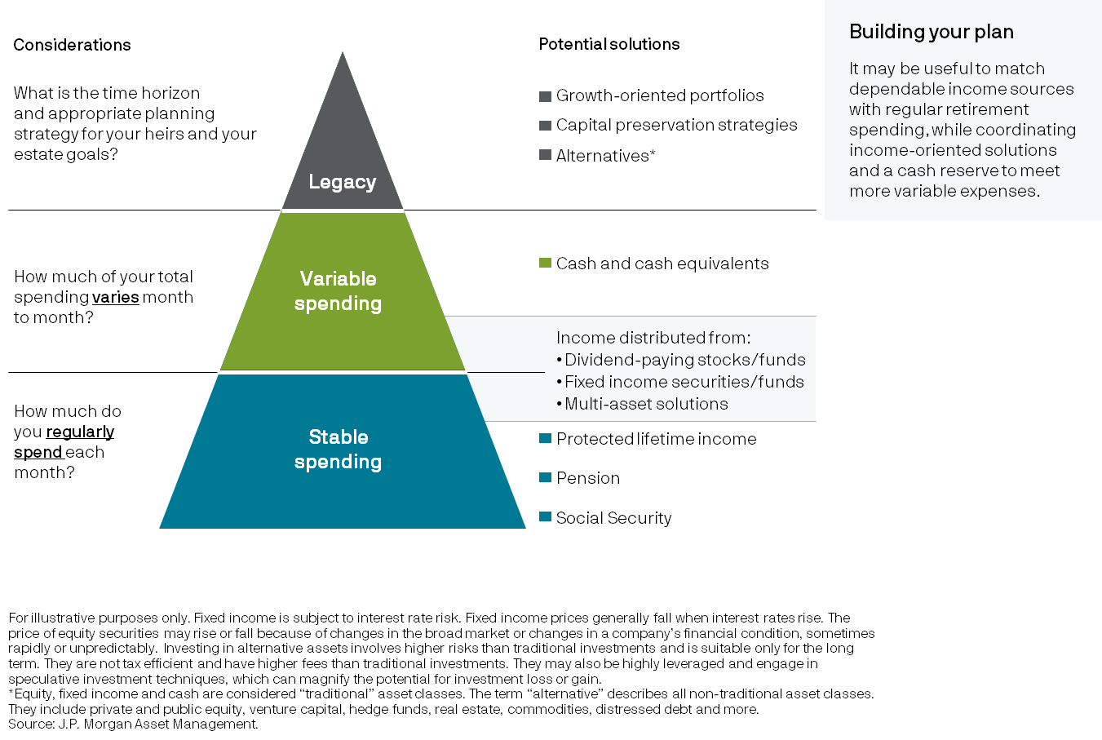
Structuring a portfolio to match investor goals in retirement
44
Investing
Notes:
Aligning retirement assets based on how they will be used to support an individual’s retirement lifestyle is one way to ensure a higher degree of confidence through retirement. Known as “guarantee the floor,” this chart shows regular or “stable spending” – what a household wants to have available each month – can be aligned with relatively safe or guaranteed funding sources. More variable spending can be covered when it occurs by investment income or a cash reserve. If leaving a legacy is a goal, strategies focused on growth or capital preservation, or that are more illiquid may make sense given the longer time horizon.

Slide 45
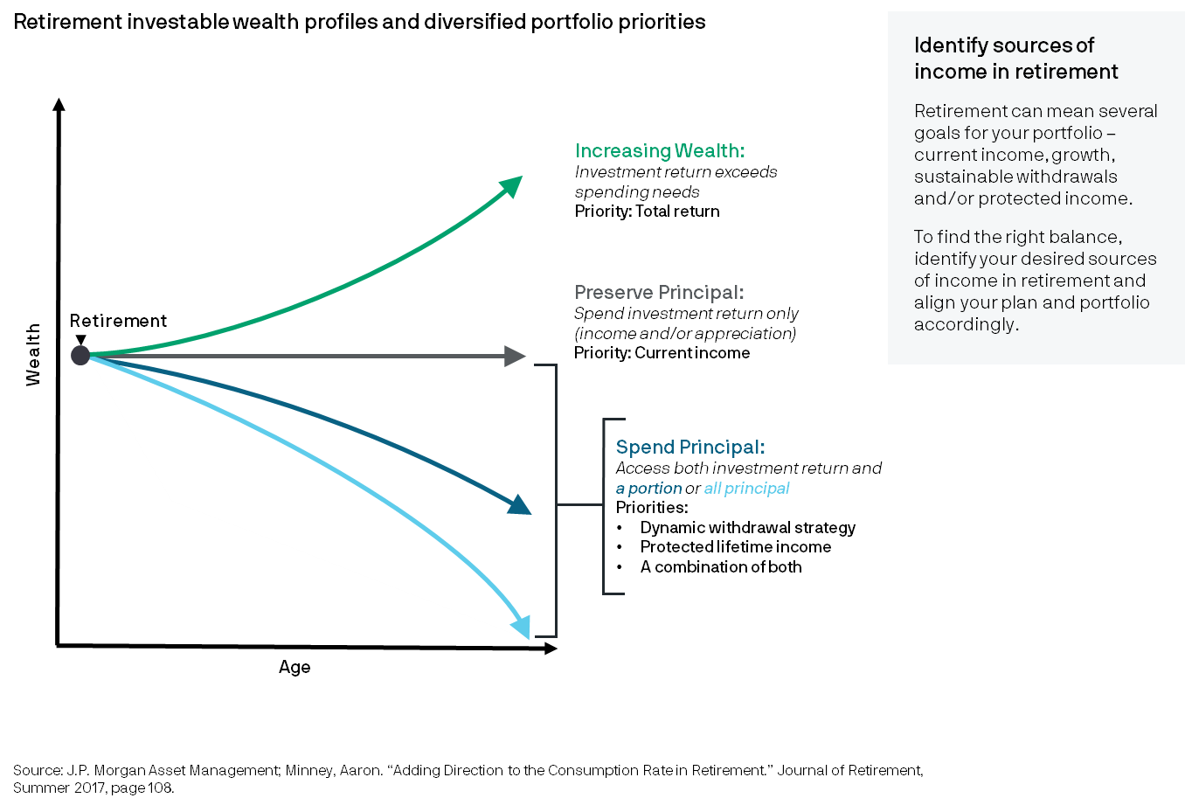
Align your portfolio with your goals
45
Investing
Notes:
When planning for retirement, a risk-based asset allocation assumption based on an investor's risk tolerance and time horizon is typically used to forecast an estimated retirement outcome. This doesn’t always match what an investor expects in practice. Implementation of the recommended asset allocation can be tailored to address the investor’s preferences. This chart shows four hypothetical retirement planning profiles and their corresponding goals. For households with increasing wealth, investing on a total-return basis, perhaps considering a longer time frame for legacy wealth, should be considered. Many households desire to preserve principal and end retirement with the same wealth as they started with (on a nominal basis). For these households, investing for current income may provide them with the funds they need to support their lifestyle. Increasingly households may need to use a portion of their wealth or “Spend Principal” to support their retirement lifestyle, particularly as access to pensions decline. These households should consider several options: a dynamic withdrawal strategy that can provide needed funds while making sure that the principal is not depleted too quickly; an annuity that can provide protected lifetime income; or a combination of both.

Slide 46
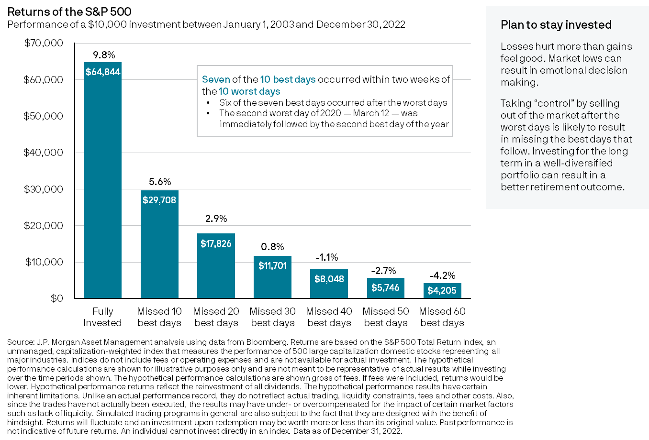
Impact of being out of the market
46
Investing
Notes:
During periods of extreme market declines, a natural emotional reaction can be to “take control” by selling out of the market and seeking safety in cash. This is due to “loss aversion” – or the fact that losses hurt more than gains feel good. The results of this action can be devastating because during periods of market volatility, the best days are likely to occur close to the worst days. This chart compares an individual who was fully invested for the past 20 years in the S&P 500 to investors who missed some of the best days as a result of being out of the market for a period of time. Missing the top 10 best days reduced the annualized return by almost 50%; missing the top 40 days resulted in a negative annualized return on the original $10,000 investment. Staying the course with a diversified long-term investment strategy may produce a better retirement outcome.

Slide 47
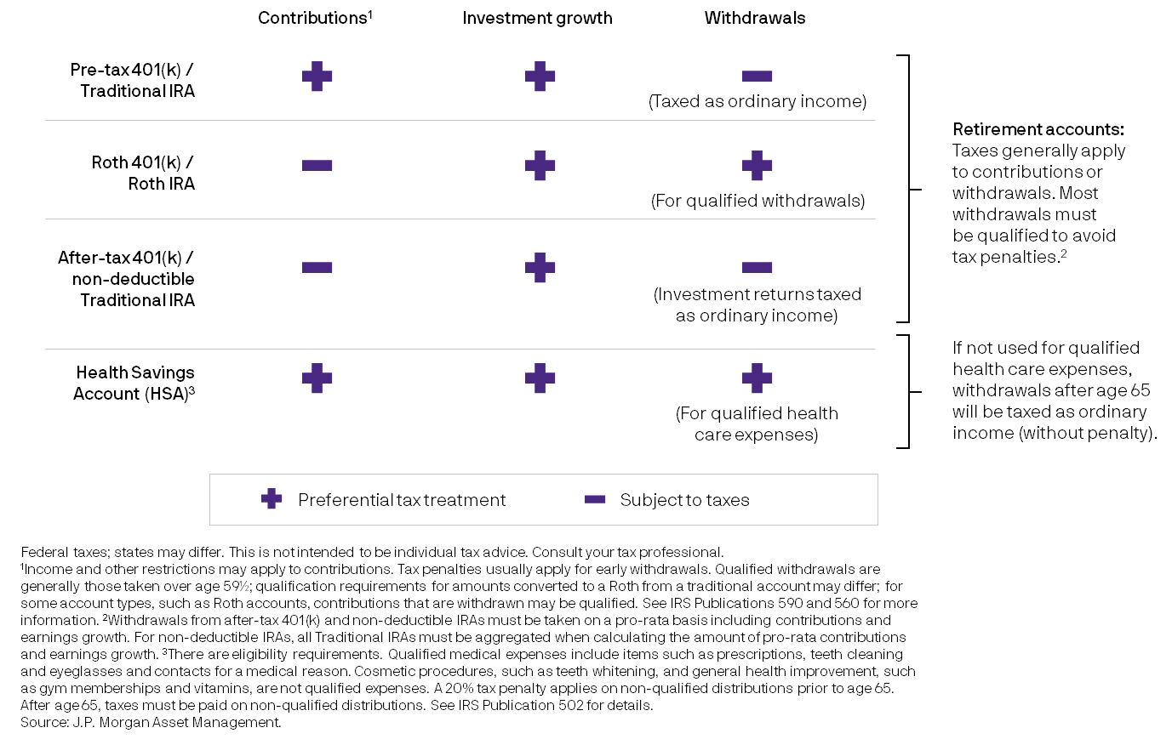
Tax implications for retirement savings by account type
47
Defined Contribution
Notes:
Different tax-advantaged savings accounts have different tax characteristics. Investment growth in tax-advantaged accounts is usually tax free, as shown with “+” in the middle column. For retirement accounts (pre-tax and Roth, top two rows), money may go in or come out tax free, depending on the account type and if the deposits and withdrawals are qualified. Health Savings Accounts (HSAs), which must be paired with a qualified high-deductible health plan, offer triple tax benefits – if the funds are used for qualified health care expenses, the funds may be entirely tax free on contributions, investment growth and withdrawals. Leaving money in HSAs to grow tax free and be taken out tax free for qualified health care expenses in retirement can help optimize HSAs’ preferential tax treatment. Non-deductible or after-tax contributions are less tax advantaged and should be considered after exhausting opportunities to save in the other tax-advantaged accounts. All of these accounts are designed for long-term saving, so generally there are penalties on early or non-qualified withdrawals.

Slide 48
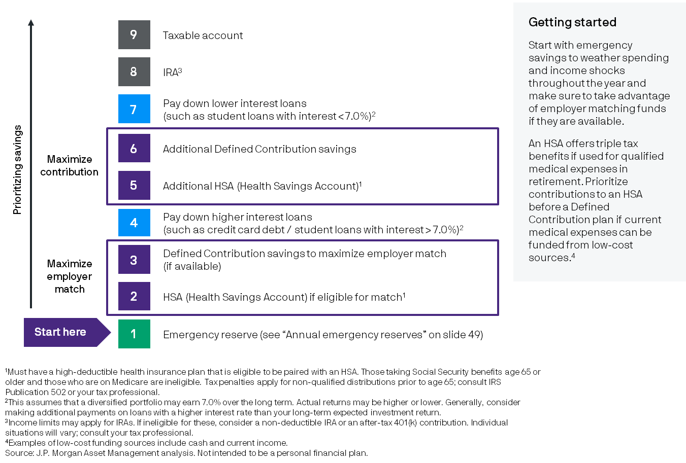
Prioritizing long-term retirement savings
48
Defined Contribution
Notes:
When prioritizing how the next dollar should be saved, factors such as liquidity needs, employer match (if available), contribution limits in various account types and loan obligations should be considered. The first savings priority should be to build an emergency reserve big enough to fund spending and income shocks throughout the year. Next, take advantage of any company match to get “free money.” Unless there are relatively high interest loans, putting more funds in retirement accounts or Health Savings Accounts, up to their contribution limits, can help maximize their preferential tax treatments.

Slide 49
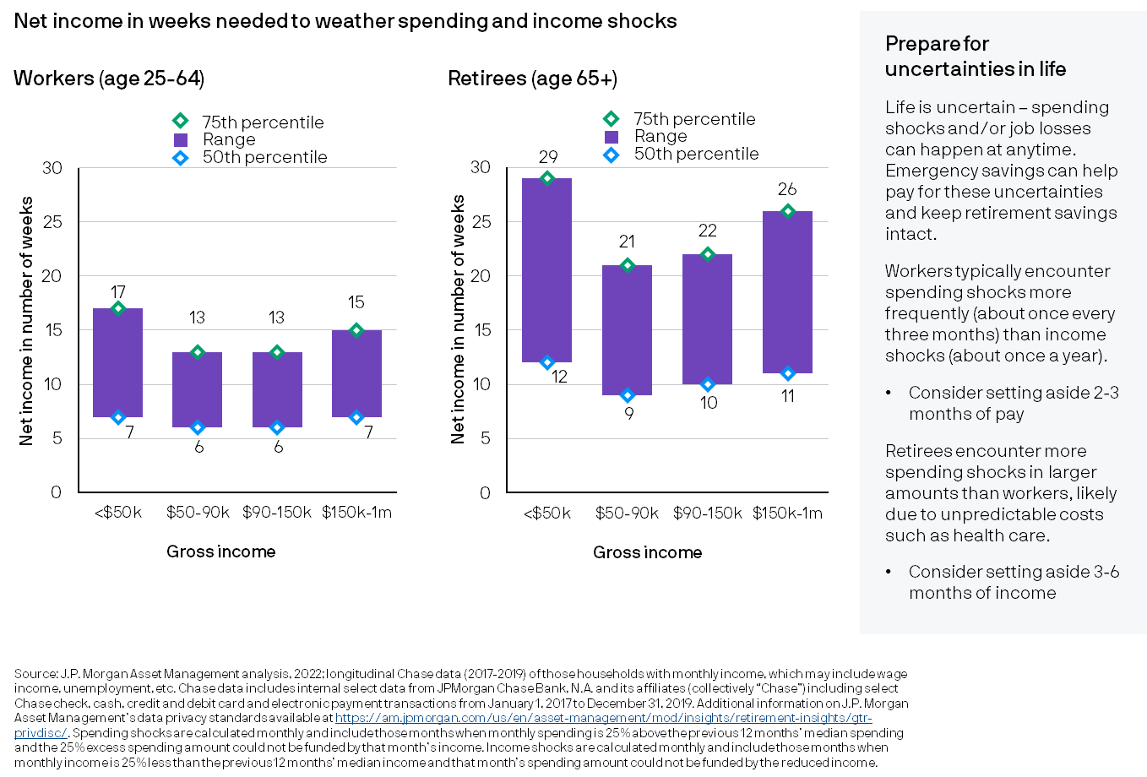
Annual emergency reserves
49
Defined Contribution
Notes:
Emergency savings is essential in building a sound and resilient financial foundation. Life is uncertain – people encounter unexpected spending shocks such as having to fix their car or income shocks from losing their jobs or reduced hours. If there aren’t funds set aside to navigate these unfortunate circumstances, people often tap their retirement portfolios to generate the needed funds. Prematurely taking money out of retirement savings accounts can have a dire consequence in achieving a successful retirement outcome. How much to set aside in an emergency savings account will vary by household – income level, unique personal circumstances and comfort level. As a general guide, consider setting aside 2-3 months of pay for those working and 3-6 months of income for those retired. Retirees encounter more spending shocks and in larger amounts than workers, likely due to unpredictable costs like health care. Lower income households need larger emergency savings because the shocks they encounter can be large relative to their baseline “normal” spending.

Slide 50
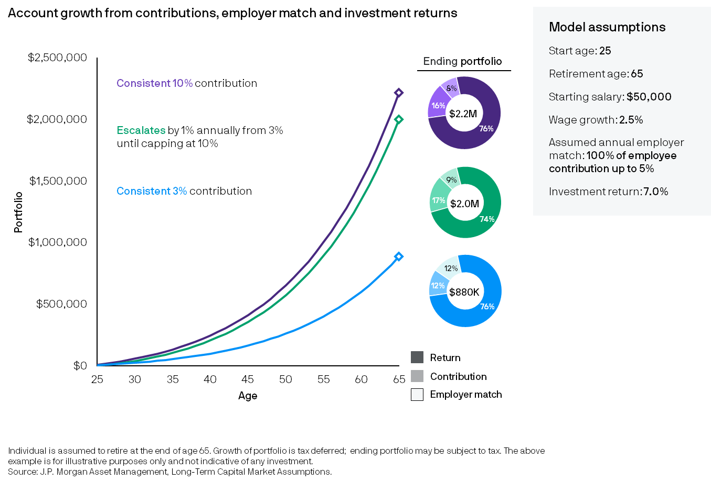
The benefits of auto-escalation
50
Defined Contribution
Notes:
Increasing contributions each year can be an effective way to save more for retirement. This chart shows three people who each have a starting salary of $50,000 that increases with inflation and a 100% employer match capped at 5%. The saver who contributes 3% throughout her career in blue is left far behind. However, by leveraging the auto escalation feature that starts at 3% and gradually increases to 10%, the saver in green ends up not far behind the saver who contributes 10% consistently. This shows the power and value of escalating contributions each year.

Slide 51
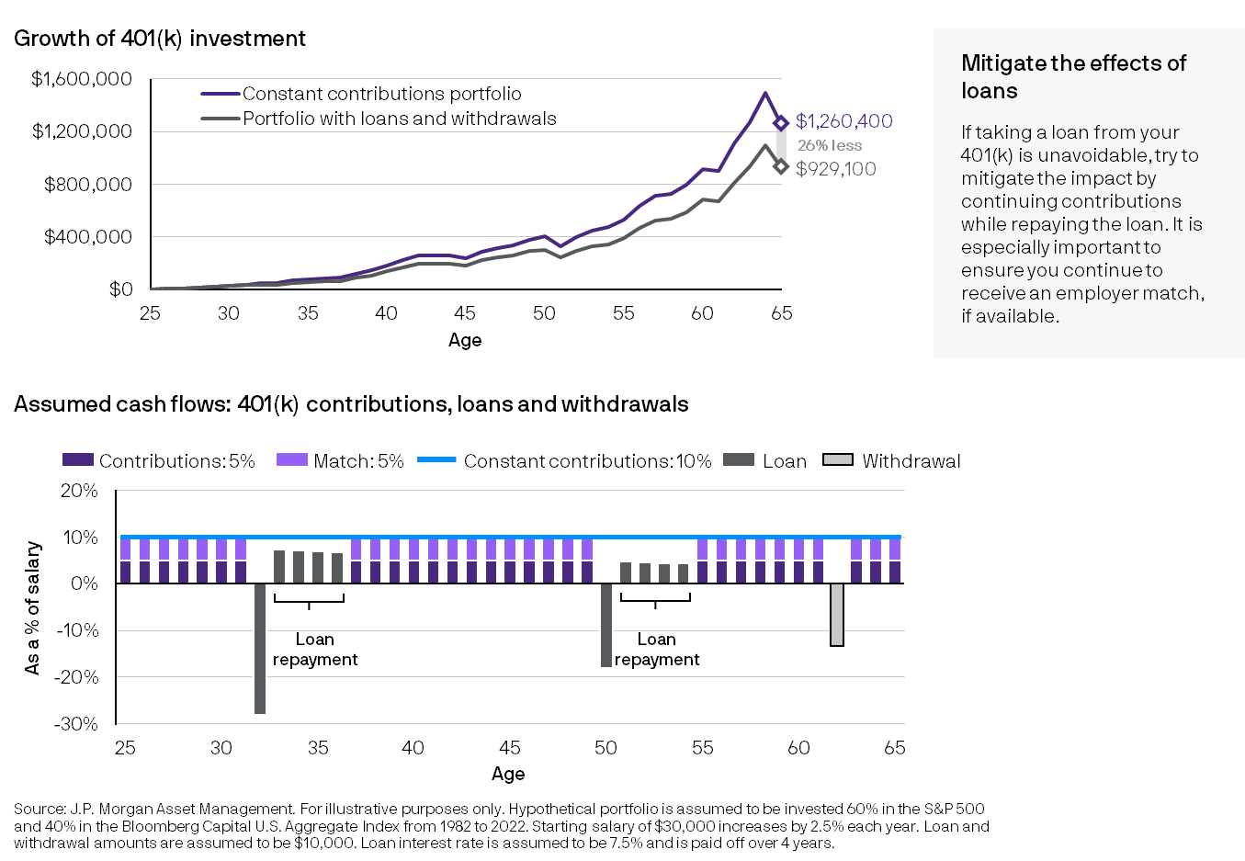
The toxic effect of loans and withdrawals
51
Defined Contribution
Notes:
Taking loans and withdrawals from 401(k) accounts may have a significant impact on overall retirement success. The top chart shows that employees who take loans and withdrawals from their 401(k) accounts may end up with significantly lower balances in the end. This is due to skipping contributions and missing the company match when paying back their loans as can be seen in the bottom chart. Having an emergency reserve and savings outside of a 401(k) can help avoid tapping the retirement accounts for liquidity. However, if the employee must borrow, continuing to contribute while paying back the loan may mitigate the negative impact of the loan.

Slide 52
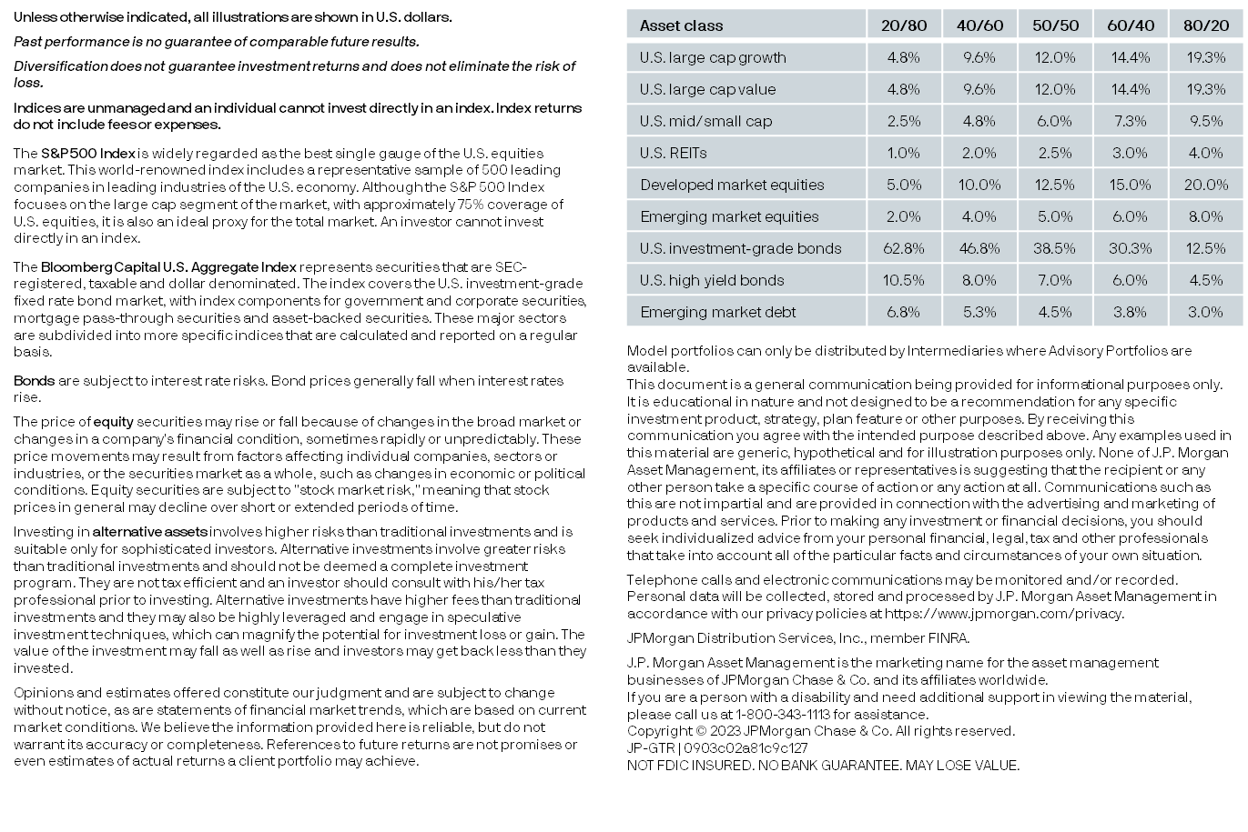
2023 disclosures

